Slide 1
Progressive Education
Class 1b

Slide 2
The “Status Quo” in Education (Late 1800s)
The Doctrine of Mental Discipline
  Plato’s Theory of Forms
    The world of ideas (forms) leads to perfect Truth and Good. It is eternal
    The material world is imperfect and constantly changing
  Certain subjects had the ability to strengthen
    Memory, Reasoning, Will power, Imagination, Character
  Metaphor- the mind is like a muscle- it needs the right kind of exercise.
High School Curriculum (the world of ideas)
  The Classics: Greek, Latin, Great Literature
  The Trivium: Grammar, rhetoric, logic
  The Quadrivium: Arithmetic, Geometry, Astronomy, Music

Slide 3
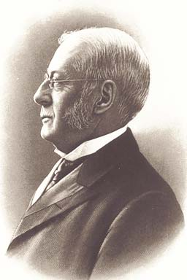
The High School Curriculum Reform
The NEA Committee of Ten (1892-93)
Lead By Charles Eliot (President of Harvard)
  Believed in “Modern Liberal Arts”
  A curriculum that was “College Prep”
  A curriculum that was “Life Prep”
Final Report (1893)
  Four liberal arts curricula were recommended but there was not distinction between college and life preparation
      Classical
      Latin-scientific
      Modern Languages (vs. Greek & Latin)
      English
    History, Math, & Science similar across each curriculum
    No Vocational Ed
Notes:
Eliot led the committee to two major recommendations. The first was earlier entry of some subjects. The second was the teaching of subjects for both college-bound and terminal students.
The Committee of Ten recommended eight years of elementary education and four years of secondary education. It defined four different curricula as appropriate for high school. The first two followed a classical trend: classical and Latin-scientific. The second two were more contemporary: modern language and English. Courses that are now considered basic like foreign languages, mathematics, science, English and history were included in each curriculum.
The significance of the Committee of Ten was its contribution towards liberalizing the high school by offering alternatives to the Latin and Greek classic curricula and the belief that the same subjects would be equally beneficial to both academic and terminal students. The goal of high school was to prepare all students to do well in life, contributing to their own well-being and society's good, and to prepare some students for college.

Slide 4
Progressive Education Movement
Progressivism- philosophic orientation based on the belief that life is evolving in a positive direction, that people may be trusted to act in their own best interest, and education should focus on children’s interests and needs.
Characteristics of Progressive Education:
  Focused on social reform and improving quality of life
  Not united by a single philosophy
  Opposed to autocratic teaching methods
    Based exclusively on textbooks, recitations, and memory
    Isolation of classroom from the real world
    Classroom discipline based on fear and physical punishment
  Teachers were guides rather than “task makers”
    Provided students with activities related to natural interests for engagement
    THEN moved students to higher levels of understanding.
    Teachers needed perceptive understanding of children and a knowledge of discipline and knowing when a child is ready to learn.
US High Schools = 40 in 1860; 2,526 in 1890; 6005 in 1900; 10,213 in 1910
(Wall Street Journal, Sept. 3, 2003)

Slide 5
The Struggle for the American Curriculum (Kliebard, 2004)
Humanists (traditionalists)
  The curriculum should reflect our Western Cultural Heritage
Social Efficiency Educators
  The curriculum should produce an efficient, smoothly running society
Developmentalists
  The Curriculum should be based upon the natural order of the development of the child
  Child Study Movement
Social Meliorists
  The curriculum should bring about social change

Slide 6
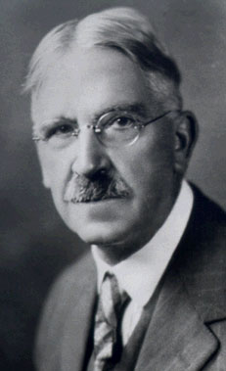
Life of John Dewey (1859-1952)
Established a laboratory school at the University of Chicago in 1903 to practice his educational theories
  Curriculum should be based on students’ interests and should involve them in active experiences.
  Active curriculum should be integrated, rather than divided into subject-matter segments.
  Teachers are responsible for achieving the goals of the school, but the specific topics to be studied to meet those goals, cannot be determined in advance because they should be of the interest of the children.
  Learning was active and should involve real-life tasks and challenges
  Educative experience, which expands a learners opportunities for learning and growth in the future; vs. miseducative experience, which stops or distorts future growth and learning.
  Music lessons involved singing, composition, & sight-singing

Slide 7
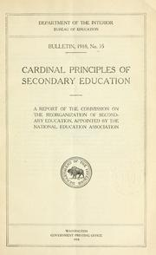
Seven Cardinal Principles of Education
(Commission on the Reorganization of Secondary Education, 1918)
Health
Command of fundamental processes (3 r’s)
Worthy home membership
Vocation
Citizenship
Worthy use of leisure
Ethical character

Slide 8
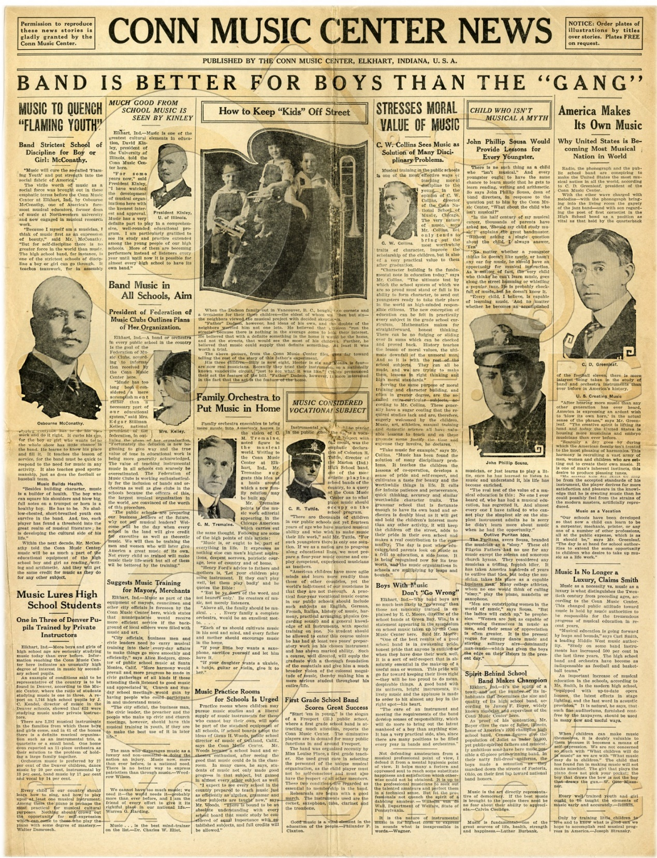
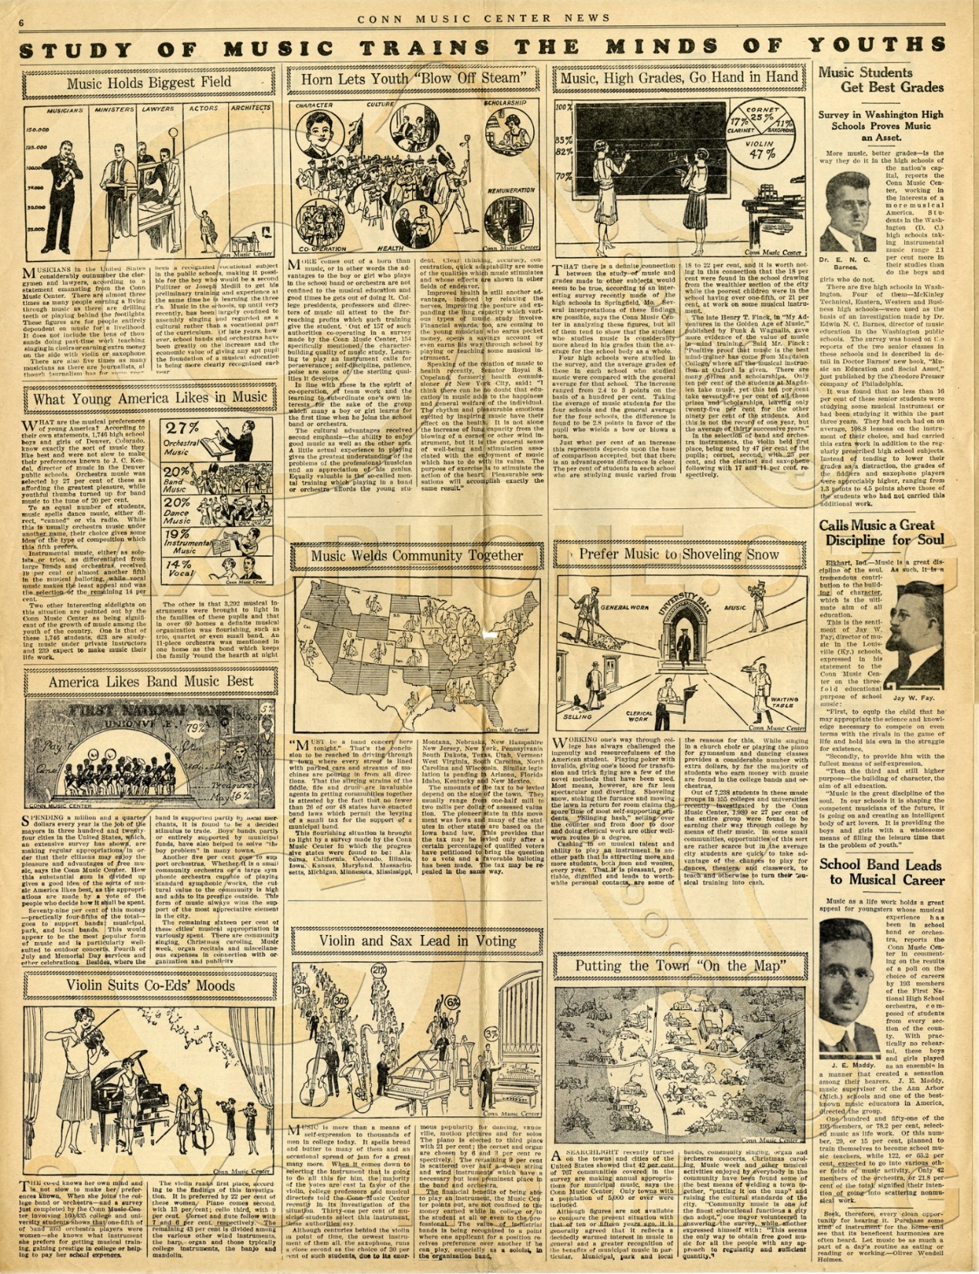

Slide 9
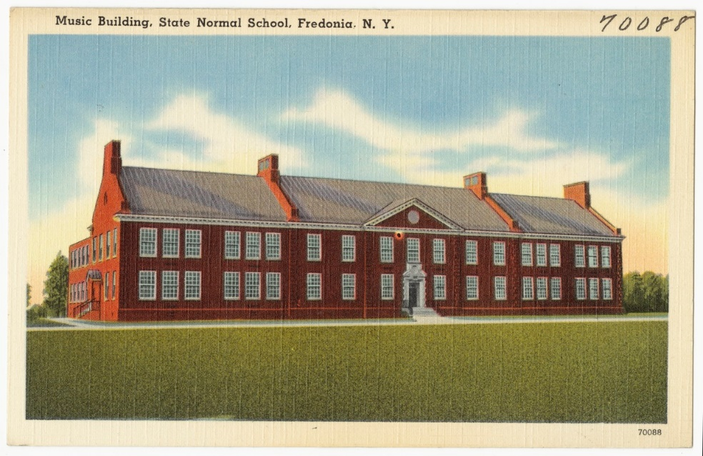
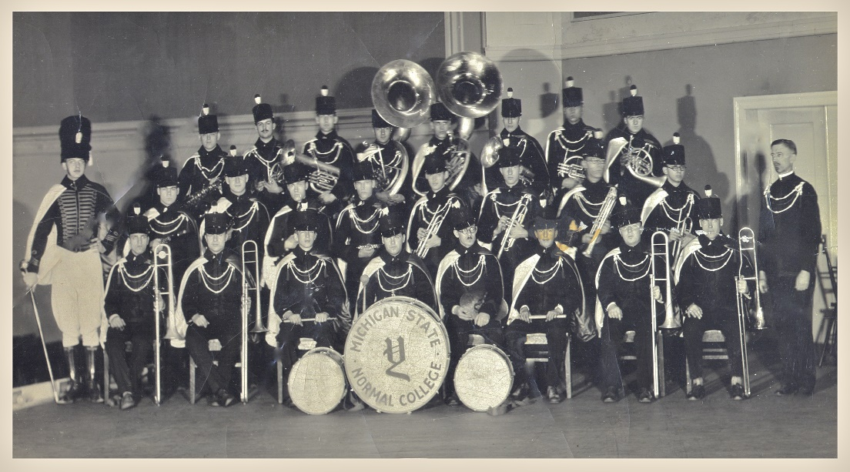
Progressive Era Developments in Music Ed
Increase in HS Music
Academic Credit for Music
  MSNC 1910 report
  Credit for applied lessons outside of school
Group Participation (to foster patriotism & social values-social meliorism)
Music Teacher Education/Certification at College Level

Slide 10
Progressive Era Developments in Music Ed
School Bands & Orchestras
  Vocational training
  Community/school functions
  Development of class teaching (social efficiency)
Music Appreciation
  Advent of Technology
  Sight singing overemphasized
  Listening developed intellect/love of Music
  Combat Evils of Jazz
Class Piano
Presto, June 1930, p. 14

Slide 11

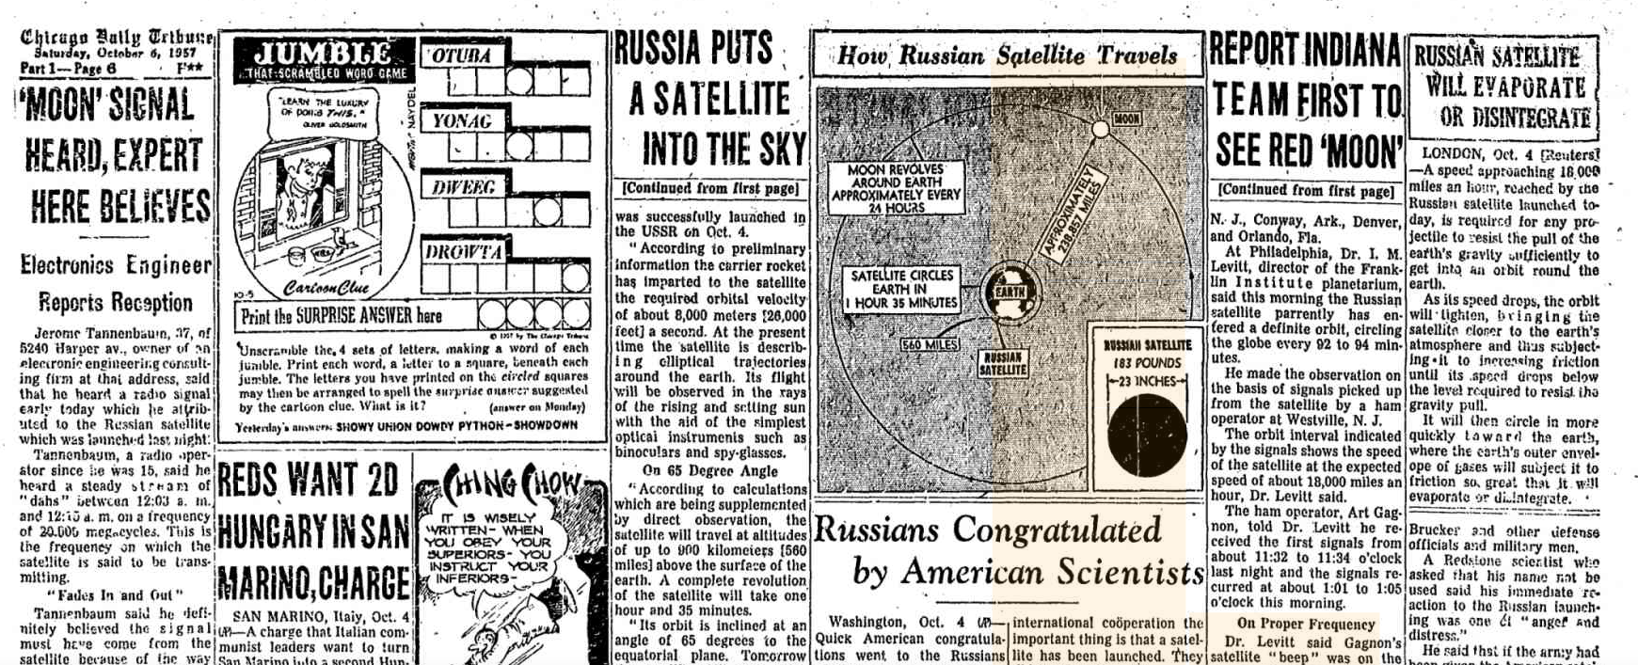
Sputnik & MEAE

Slide 12
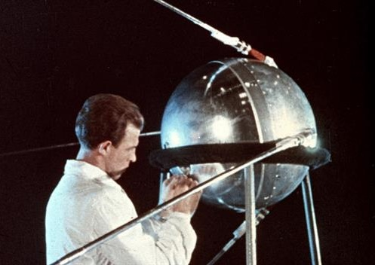
Reactions to Sputnik
US Education to Blame
More STEM
What about my job? (arts teachers)
BUT I found:
  Not cuts resulting from more STEM
  No calls for cuts in the arts
  Much support for the arts from NASSP
  Was this threat (and some today) real?
What Sputnik did was cause discussion & reflection on music ed

Slide 13
MENC Leadership Meeting (Oct. 11-14, 1957)
Self-imposed self-evaluation-"a reassessment of music education in its contribution to general education in the light of present practices, present needs, and results.“
Held at MENC Headquarter in Washington DC
During cold war just after the Sputnik launch (Oct. 4, 1957)
“What are the principal needs, what should be the next steps, what should be the goals?”
“Inventory of our beliefs regarding: (a) Music, its place and function in general education. (b) What music education should do for children, youth and adults of all varying degrees of musical interest and ability. (c) How music education should function to fulfill most adequately its purposes with human beings.”

Slide 14
MENC Leadership Meeting (Oct. 11-14, 1957)
Expressed concern for music teaching as a profession (threats from STEM)
Questioned quality & value of performance ensemble repertoire
Called for increased instruction of “recreation, light, easy-to-play instruments” for personalized use of leisure time
Less service oriented performance of instrumental groups
More research on music teaching and learning (JRME est. 1954) including historical research
Balanced Music Programs
Greater connection b/w Elem/Sec. programs
“We should be developing a more musically-rounded teacher who can teach the balanced program in music education”
(a) In many school systems music education virtually disappears at the secondary school level. (b) Teachers are often in conflicts between community demands and school demands. This does not result in a satisfactory teaching experience. (c) There is imperative need for thinking together with school administrators and curriculum directors. (d) We often generalize too much about the values of music education. (e) Many music teaching materials in the elementary schools-i.e., the books follow similar and unoriginal formats. (f) Too many music teachers have learned a method and continue teaching a method, rather than attempting to meet today's opportunities

Slide 15

Other Summits on Music Education
Yale Seminar (1963)
  Musicologists, pro musicians, non-music educators
  Music Ed has not kept up w/ 20th century music developments
  Julliard Repertory Project
    Collected authentic Western art and folk music for use in K-12 ed
    “Music educators obviously were not seeking authentic music of high quality that represented various periods and genres for their programs.” (Mark & Gary, 2007)

Slide 16
Other Summits on Music Education
Tanglewood Symposium (1967)
  How can music education be more useful to American society?
  Response to Yale Seminar
    Similar recommendations
    Increased access for underserved populations & special learners
    More diversified music teacher education
    Led to goals & objectives project (1969)
Vision 20/20: The Housewright Symposium on Music Education (1999)
  FL State University
  Papers asking question on the future of Music Ed.
  12 agreements resulted (Mark & Gary, p. 450)

Slide 17
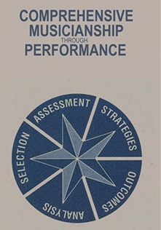
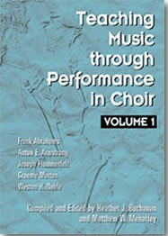
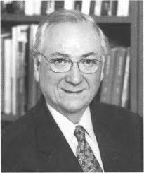
Music Education as Aesthetic Education (MEAE) (1958[?] – present)
  The purpose of MEd is to teach people to perceive expressive elements at deeper and deeper levels so that they will understand a (hopefully) come to value a wide range of music. “The development of sensitivity to aesthetic qualities of things.”
Emphasis on listening, analysis, Western art music, context
Evolved over last 60 years to embrace importance of musical context & value of performance education
Not an outdated approach
  Comprehensive Musicianship through Performance
  Teaching Music through Performance series
  Journal of Aesthetic Education
Music Appreciation in the School Room[?] (1926)
Basic Concepts in Music Education (NSSE, 1958)
  “A Realistic Philosophy of Music Education (Harry S. Broudy)
Foundations & Principles of Music Education (Leonard & House, 1959, 1972)
Philosophy of Music Education (Reimer, 1970, 1989, 2003)

Slide 18
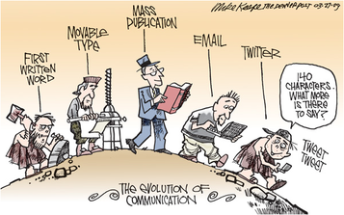
What is Music According to MEAE
One Philosophical approach to Music ed.
  What is music = object
  Music reflects and embodies the emotions of everyday life (tension/release, conflict/resolution, ebb/flow, moves through time
  Music is connected to everyday life
  Meaning/value is internal but influenced from outside of the music – context
Responding to music is an aesthetic experience
  “An aesthetic experience is one in which your senses are operating at their peak, when you are present in the current moment, when you are resonating with the excitement of this thing that you are experiencing, when you are fully alive.” Sir Ken Robinson

Slide 19
Quote
"When you think about the purposes of education, there are three[.] "We're preparing kids for jobs. We're preparing them to be citizens. And we're teaching them to be human beings who can enjoy the deeper forms of beauty. The third is as important as the other two." Tom Horne – AZ State Supt. of Public Instruction

Slide 20
Praxial Philosophy of Music Education
David Elliott (1995)
Music Matters: A New Philosophy of Music Education

Slide 21
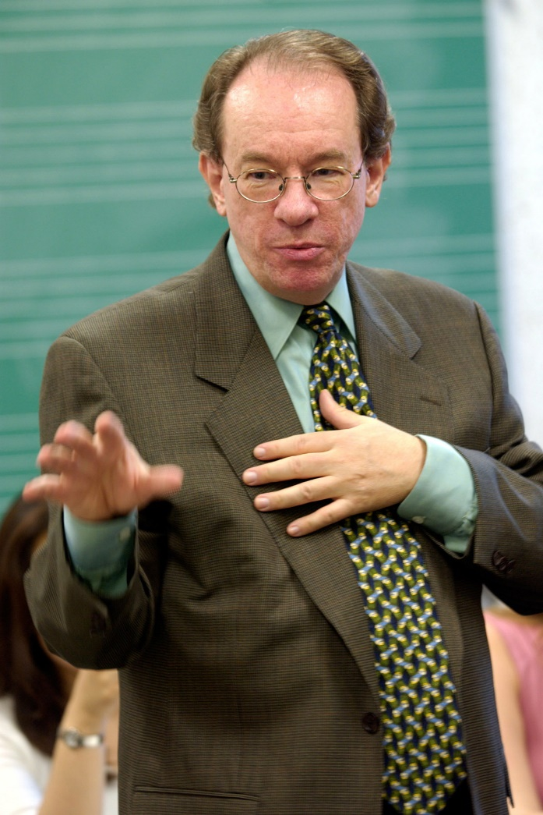
Praxial Music Education (mid 1980s – present)
Praxial comes from the word “praxis” = action embedded in and responsive to a specific context of effort.
Key idea: A full understanding of the nature and significance of music involves more than an understanding of pieces or works of music
Music as something humans do and make that is purposeful, contextual, and socially-embedded
Culturally specific traditions & practices

Slide 22
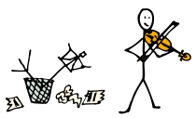
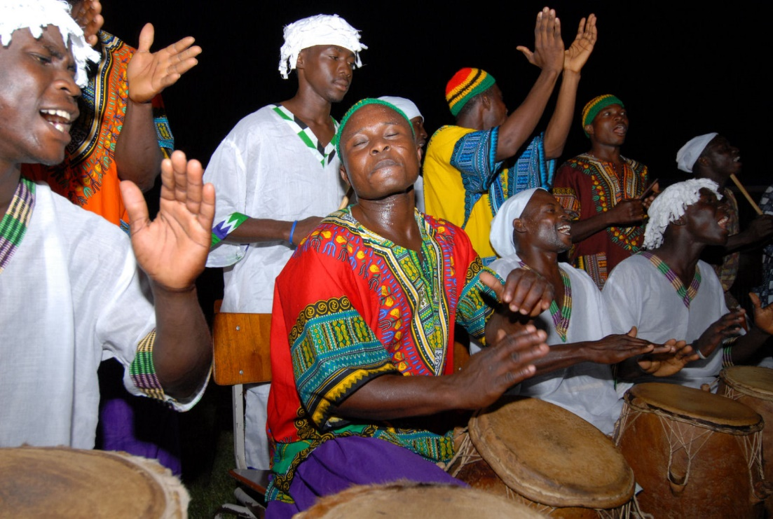
MEAE Inadequate
Music as “work” or “object” did not account for all types of music. Focused on Western music.
Music more than an object
Did not account for music participation
  What are some examples of music that are primarily about participation rather than listening?

Slide 23
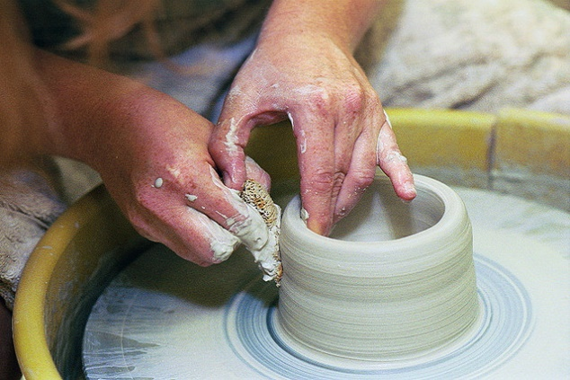
Praxis Music Education
Education rooted in the knowledge & skills required to create, make, or produce something rather than in pure knowledge.
  Working with your hands (or vocal chord or embouchure)
  More than skills
    Understand the practice you are involved in
    Requires sophisticated forms of “thinking in action”
      Making decisions while I am in the process
      You are thinking as you make music, not simple executing skills
    If woodworking is a skill, will the ability to manipulate tools mean I can create a beautiful work of art from the wood?
    Practices are culturally bound and distinct (baroque aria singing vs. jazz scat singing)

Slide 24
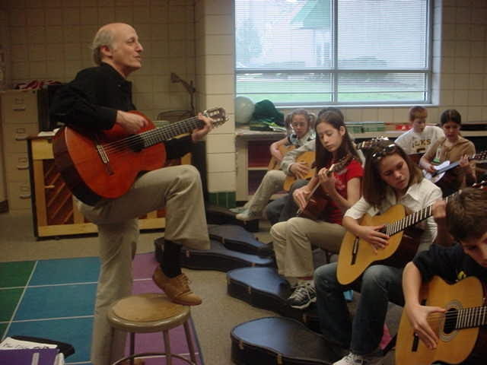
What is Music
MUSIC is a diverse human practice
Music is a particular form of that practice [Jazz, Irish Bagpiping, Baroque violin per.]
music is what is created from the practice
Music is primarily something you do using procedures based on cultural historical traditions. Music making should be central goal of music education

Slide 25
Orientations of MEAE & Praxis Philosophies of Music Education (in purest form)
MEAE
  Product
  Noun
  Connoisseur as model
  Listening
  General Student
  Music as feeling
  Western art music
Praxial
  Process & context
  Verb
  Musician as model
  Performing
  Promising apprentice
  Music as feeling AND other experience or uses
  All types of music

Slide 26
Assignment
TODAY
Mason, L. (1834). Manual of the Boston Academy of Music (1834) pp. 9-23. Accessed from https://books.google.com/books?id=VT4uAAAAYAAJ&printsec=frontcover&dq=editions:gTv32pzapSYC&hl=en&sa=X&ved=0ahUKEwiv_rGdqqrNAhUHkx4KHVr0CY0Q6AEIMTAE#v=onepage&q&f=false
Cardinal Principles of Secondary Education (Dept. of the Interior, Bureau of Education, Bulletin 1918, no. 35). Accessed from https://archive.org/details/cardinalprincipl00natiuoft
Kleihauer, A. (1958, February). Automation: The problem of being a person. NASSP Bulletin, 42 (235), 48-52. (SAGE)
FRIDAY
Crawford, R. & McKay, D. P. (1973). The performance of William Billings' music. Journal of Research in Music Education, 21(4), 318-330.
OR
Lowens, I., & Britton, A. P. (1953). ‘The easy instructor’ (1798-1831): A history and bibliography of the first shape note tune book. Journal of Research in Music Education, 1(1), 30-55.
AND
Volk, T. M. (1993). Factors influencing music educators in the "rote-note" controversy, 1865-1900. Bulletin of Historical Research in Music Education, 15(1), 31-43
Mason, L. (1863). The Song Garden, book one, pp. iii (preface) - p. 20. https://archive.org/details/songgardenseries01maso
Tufts, J. W., & Holt, H. E. (1883). Normal Music Course, first reader, pp. iii-xvi. https://archive.org/details/normalmusiccours00tuft

