Slide 1
Content Analyses, Surveys, Descriptive Statistics
Class 2

Slide 2

For Tuesday
Chapter 1 – due
Revised abstracts from class 2
Read four additional research articles and write abstracts for your chapter 2. If possible, include articles using basic descriptive stats and/or an experiment.

Slide 3
Terms/Concepts from Tuesday
Peer-Review vs. Non Peer-Review Research Based vs. Non-Research Based Experimental Research Descriptive Research Qualitative vs. Quantitative Research Historical Research Philosophical Research Correlation Research APA Style Action Research
Research Proposal Framework Consensus Deductive Inductive IRB Treeing Back Literature Review Research definition Content analysis

Slide 4
Content Analysis
Examples:
  Hash (2005). MS Band Contest Rep in Northern IL
  Hash (2015). Open music educator positions in faith-based schools: 2013-14
  Articles (topics, authors, methods, etc.) in periodicals
  Sessions at conferences
  Songs in Gen Music Collections
Mostly descriptive statistics
Does not involve human subjects.
Patterns in interest or trends in the profession
ID future directions or research
Gaps in curricula or materials

Slide 5

Content Analysis Process
Determine research questions
  Specific focus vs. “let’s see what’s in here”
ID materials to analyze
ID & classify relevant content
Determine how to analyze (quantitative or qualitative)

Slide 6
20 Years of the MENC Biennial Conference A Content Analysis
Joshua Palkki, Daniel J. Albert, Stuart Chapman Hill, Ryan D. Shaw
JRME Vol 64(1), 2016
The purpose of this study was to investigate the content and intended audiences for educational sessions offered at MENC biennial conferences in order to illuminate trends and topics in professional development. The researchers performed a content analysis of each session (N = 2,593) using program booklets from conferences between 1988 and 2008, creating a coding scheme with separate codes for audience focus and session content. After establishing sufficient interjudge agreement, the researchers coded all educational sessions offered at the conferences from 1988 to 2008. Results indicated that the number of sessions targeted at specific audiences (e.g., choral teachers only) remained small relative to those targeting broader audiences. Content coding revealed large increases in the number of sessions focused on technology and a slight decrease in the number of sessions focused on traditional large ensembles. Session content sometimes followed professional trends (e.g., the inception of the National Standards in 1994) but did not reflect increased attention in the profession to topics such as creativity and students with exceptionalities. These findings have important implications for those planning state and national music education conferences and for music educators who attend these professional development events.

Slide 7
Student Teaching in Music:
A Content Analysis of Research Journals in Music Education
Jason M. Silveira, Frank M. Diaz
JMTE Vol 23(2), 2014
The purpose of this study was to examine research being conducted on student teaching in four eminent music education research journals (Journal of Research in Music Education, Journal of Music Teacher Education, Update: Applications of Research in Music Education, Bulletin of the Council for Research in Music Education). A total of 1,103 articles were reviewed for the period between 1997 and 2011. Only 87 (8%) articles met the inclusion criteria. These included 44 articles in Journal of Music Teacher Education (29% of total), 20 articles in Journal of Research in Music Education (5% of total), 18 articles in Bulletin of the Council for Research in Music Education (5% of total), and 5 articles in Update (3% of total). Consistent with previous research on student teaching, a majority of the publications examined dealt with student teachers’ perceptions of their experiences (33%), and the relationship between teacher preparation programs and partner K–12 schools (26%), whereas only one publication (1%) examined the effect of student teachers on students’ learning.

Slide 8
Sight-Singing Pedagogy: A Content Analysis of Choral Methods Textbooks
Eva G. Floyd, Marshall A. Haning
JMTE: Vol 25(1), 2015
The purpose of this study was to examine the sight-singing pedagogy content of choral methods textbooks, with the intent of determining what elements of sight-singing pedagogy are most commonly included in these resources. A content analysis was conducted to analyze information related to sight-singing pedagogy in 10 textbooks that are commonly used in undergraduate choral methods courses. Results of this content analysis indicated that although most choral methods textbooks contain some information about teaching sight-singing and music literacy skills, this information is often quite limited and does not include reference to helping students internally organize sound. In addition, information about concepts such as assessment and curriculum planning for sight-singing skills is included in only a small percentage of popular textbooks. Evaluation of these findings can help to illuminate the ways in which textbooks communicate the priorities and core values of a particular field of study, such as choral music education.

Slide 9
Surveys & Inventories

Slide 10
Survey Example
Dear Member,
The following research opportunity is being sent as a public service on behalf of a legitimate researcher by the National Association for Music Education. Your e-mail address has not been disclosed to any third party, and any information you supply as part of this survey is optional.
Greetings,
We are writing to request your participation in a research project by completing a questionnaire about current band director practices. Your responses will give us greater insight into what currently occurs in the band classroom as well as band director views of current practice. The investigators for this project are Jason Gossett, Oregon State University (principal investigator), Dan Shevock, Penn State Altoona, and Linda Thornton, Penn State.
Completing this short questionnaire will take about 15 minutes. We are unable to offer any compensation for your participation in this research, and we are not aware of any risks to you for your participation. If you are willing to participate please click on the link below:
Band Director Practices
We thank you for participating in this project. Should you have any questions you can contact Jason Gossett through any of the methods listed below.
Thank you,
Jason B Gossett
Dan Shevock
Linda Thornton

Slide 11

Survey Research
A purpose is stated w/ research questions
A population is selected (to whom do you want to generalize results?)
A mode of data collection is selected (survey, inventory)
A sample is selected (sampling methods)

Slide 12
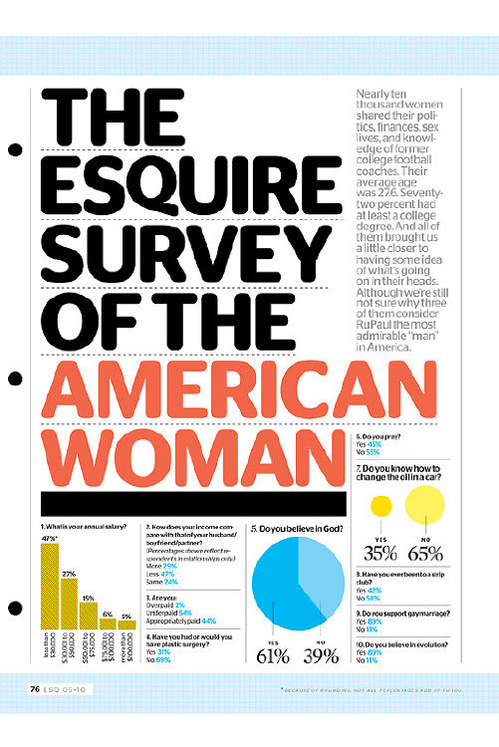
Survey Research
The instrument is chosen/constructed/adapted
Can Choose From:
  Previous research
    Reliability & Validity have been established
    OK to modify
  Commercially available
    Reliability & Validity established
    Costs $
  Online
    Instrument may not have undergone any type of formal testing
    Equivalent to a Cosmopolitan survey

Slide 13
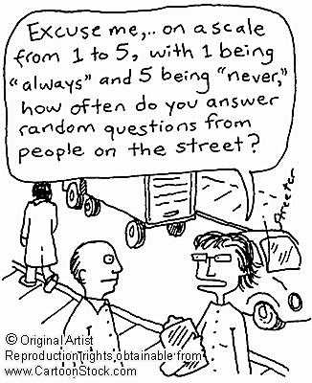
Survey Research
Information related to the purpose/problem is collected from a group of individuals (administer measure)
The information is summarized and analyzed
From the results, generalizations are made about the population in question

Slide 14
ID the Population and Sample
Define the population so that is clear who may or may not be considered in the sample
Some form of random sampling is best once population is defined
Convenience sample – OK for our purposes
  Intact classes
  Faculty/administrators
  Group of parents

Slide 15
Samples of individuals/entities
Sample vs. population
  Some vs. All
  Examples where entire population could be sampled?
Relationship between sample specificity and generalizability
Representative sample
  Captures relevant and essential characteristics of the population
  What about a sample of teachers? What should the sample look like?

Slide 16
Sampling Methods
Systematic
  Random start and sampling interval
    i.e., Randomly select pages from IHSA directory
    choose every ? Name (random number b/w 1-X)
Convenience
  not as valuable but frequent in ed. research – why?
    i.e., intact classes, pre-service teachers from one institution, conference session attendees
Purposive
  Participants fit a particular profile (female band directors in small towns)
  Exclude those who do not fit profile
  Often consists of volunteers (problematic)

Slide 17
Types of Samples
Simple Random
  Everyone has equal chance of selection
  Reduce systematic bias – error created by sampling method
  Phone book, MENC membership list (But??)
Stratified Random
  Similar proportions between sample and population
    Gender, race, age, instrument, etc.
Cluster Random
  Groups rather than individuals
    i.e., classes or ensembles in CPS
    Then groups can be assigned randomly
  Two-stage random - groups then individuals
    i.e., choose classes then assign individual students or groups to control or treatment group

Slide 18
Sample Size
As large as possible given reasonable expenditure of time and energy
  Most likely to get significant results
  More statistically powerful (more likely to find a significant difference b/w groups)
Sample size relative to:
  the size of population (50 Cook Co. band directors vs. 50 band students throughout US)
  variability within population (years of teaching, gender, etc.)
  sampling method (need a large enough pool from which to draw)
  study design (qualitative vs. quantitative)

Slide 19
Survey/Interview Types
Cross-sectional
  Information collected at one point in time
    most common
Longitudinal
  Information collected at MORE than one point in time
    Trend study – different subjects from a changing population measured over time (4th graders studied every year)
    Cohort study – Same population, different sample every time (Beginning IL music teachers that started in 2011-different sample taken from same group every measure)
    Panel Study – same sample of respondents over time (track group of 1st graders through HS)
Interview
  Standardized/structured, semi-structured, open-ended
    Code data

Slide 20
Data Use in Survey Research
Usually Descriptive
May also be associational
  Correlations among items (i.e., self reported ratings of performance ability and practice time)
  Comparisons between groups on items (differences in responses b/w males & females, novice & experienced teachers, musical experience vs. non-musical experience, etc.)
  Comparisons within group on items (compare all participants on preferences for Ren, Bar., Class, etc.)
Rarely experimental – but can be if treatment is intended to alter attitudes

Slide 21
Choose Mode of Data Collection
Direct administration
  Pro
    When researcher has access
    Response rate often excellent
    Can clarify on the spot
  Con
    Intact groups may not be representative of population
Mailed/emailed survey
  Pro
    Access to individuals who are hard to reach
  Con
    Response rate is often poor
Telephone interview
  Pro
    Cheaper and quicker than a personal interview
  Con
    Poor response rate
    Compromises anonymity
Personal interview
  Pro
    Good for encouraging participation
    Can clarify on the spot
    Can probe for more info. or detail
  Con
    Very time consuming
    Very costly
    May require assistants - who then need extensive training
    Compromises anonymity

Slide 22
Questions/Items
Questions need to be important and interesting enough to merit response
Consider a hierarchical approach to question selection
Also avoid asking for information to be reported when you can find it elsewhere (i.e., unobtrusively)
In instructions, make sure they understand that data will be shared (IRB procedures)
Random order (www.random.org)

Slide 23
Types of Survey Items
Closed Response
  Easier to score
  Harder to write
  May not include subjects’ desired responses
Open Response
  Harder to score
  Easier to write
  Subjects can say whatever they want
Gateway/Contingency/Filter - good when items may only apply to some of the subjects (“If you do not play in the band, skip to question X)
May be best to consider a combination (Use more closed than open questions. Only use gateway when appropriate)

Slide 24
Other forms of Questions
Nominal Questions
  responses are assigned a number with no meaning. (i.e., gender, level of education, age, etc.)
Dichotomous Questions
  Questions with two possible responses (i.e., yes, no)
Single Choice Question
  Respondent may only choose one response (Likert scales)
  Rating Questions (Likert scales, etc.)
Multiple option question
  Respondent can select more than one option (check all that apply)
Ordinal Questions
  Rank a list of items (i.e., rank the following songs from your favorite (1) to your least favorite (5).

Slide 25
Semantic Differential
Likert Scale

Slide 26
General tips when constructing items:
Avoid ambiguity – Clear, direct statements
Focus on one issue at a time (no double barreled questions)
Shorter is better
Use common language rather than jargon
Avoid triggers for bias (key words)
Avoid ‘leading language’
Avoid double negatives
Avoid words such as “very” “extremely” etc.

Slide 27
More Questions Designing Tips
Make sure your survey questions match your research objectives
  validity-are you measuring what you intend to measure. How do you know?
  Know exactly why you are asking a particular question
Understand your research participants
  Take age into account
  Test reading level (Flesch reading ease score [1-100-higher the score, easier to read-elementary students need 90+]; Flesch-Kincaid Grade Level Score)
Use natural and familiar language (not academic)
Write Likert scale questions in one direction (i.e., respond to positive statements about music class anchored by “strongly disagree” and “strongly agree”
  Avoid having to transpose numbers for statistical analysis
  Will avoid confusing respondents (but may make them read questions less carefully)

Slide 28
Response Issues
Problem: those who do not respond may differ from those who do on some critical issue in some systematic way
Return rate matters!
Ideas for increasing response rate
  Face-to-face = best, Telephone = 2nd, Mail = 3rd
  Confidentiality, anonymity
  Organized survey/interview
    Business-like, conservative interviewer characteristics
    Short as possible while still getting good data
    Multiple mailings/emailings
      Post-card/message ahead of time, survey and cover letter, reminder, 2nd contact, reminder, 3rd contact, etc.
      Call specific individuals
    Tangible rewards {?}

Slide 29
Online Surveys
http://www.kwiksurveys.com/
  Free and unlimited
https://freeonlinesurveys.com/#/
  Free up to 50 responses in 10 days
  $9.95 per month for students
http://www.surveymonkey.com/
  Only 10 free questions
  Must pay annually
Google Forms
  https://docs.google.com/a/calvin.edu/forms/d/1_nLrIKKBks7VRIU9FMWeLdEPIBHinPiBgf8138PybBM/edit

Slide 30
Practice Writing Items (in pairs)
Create a 7 item survey. Choose a topic (what are you going to survey? What is your study on?) [use your topics]
  1 yes/no question
  2 multiple option questions
  3 Likert scale questions (single option)
  1 ranking question
  List demographic info you would gather from your participants

Slide 31
Preservice Classroom Teacher’s Attitudes toward Music in the Elementary Curriculum
(JMTE, spring 2010)

Slide 32
Purpose
Survey preservice classroom teachers at Calvin College in Grand Rapids, Michigan, to determine their attitudes towards music in the elementary curriculum.
The Michigan State Board of Education (2008) recently adopted new standards requiring that IECTs know and be able to manage instruction for all core content areas including music.
  Colleges and universities throughout the state have revised or instituted coursework to meet the new standards.
  At Calvin College, this process involved creating a new three-credit hour music and visual art methods class to be implemented in the fall of 2011. This course will include seven weeks of music and seven weeks of art taught by a specialist in each area.

Slide 33
Research Questions
1) What musical experiences and abilities do PECTs possess?
2) What attitudes do PECTs hold regarding the roles of the classroom teacher and music specialist in teaching music?
3) How comfortable are PECTs with teaching music as a subject and integrating music with other disciplines?
4) How do PECTs rate the importance of music in relation to other subjects in the elementary curriculum?
5) How do PECTs rate the importance of various outcomes of the general music curriculum?
6) What implications might these findings have for teaching music to PECTs?

Slide 34
Literature Review
PECTs attitudes
  Shaped through apprenticeship of observation (Anderson & Piazza, 1996)
  Reflect those of former teachers (Abril & Gault, 2005)
  Resistant to change (Anderson & Piazza, 1996; Kagan, 1992)
  Unarticulated and simplified (Pajares, 1992)
  Similar for all subject areas (e.g., Hudson & Hudson, 2007; Stuart & Thurow, 2000)

Slide 35
Lit Rev.
Beliefs Regarding Music Ed.
  Shaped by childhood experience (e.g., Abril & Gault, 2005; Berke & Colwell, 2004; Hagen, 2002)
  Students teach as they were taught
Music experience my be a characteristic of ECTs in general (Abril and Gault, 2005; Colwell, 2008; Colwell & Berke, 2004; Wiggens and Wiggens, 2008)
IECTs & PECTs believe music is important, but not as important as other subjects (Abril & Gault, 2005; Berke & Colwell, 2004; Giles & Frego, 2004; Krehbiel, 1990)
Elementary teachers are often uncomfortable teaching music and accept less responsibility for doing so when a music specialist is available (Byo, 1999; Giles & Frego, 2004; Hagen, 2002; Koops, 2008; Wiggens & Wiggens, 2008)

Slide 36
Lit Rev.
Around 94% of elem. schools in US provide music instruction (NCES, 2002)
  full time music specialist (72%)
  Part time music specialist (20%)
  Only 11% of IECTs in the US teach music
  7% use other alternative
  Some use a combination of these options
IECTs that integrate music do so in extra-musical ways

Slide 37
Method
Survey of PECTs (N = 116) from Calvin College during 2008-09 academic year (see Appendix)
  39 questions/33 closed response Likert data
  Validity checked by 2 elem music teachers & one other college music ed. faculty
  Part 1 – background info including music exp.
  Part 2 – attitudes towards teaching and integration
  Part 3 – rate importance of sub. in elem. curr.
  Part 4 – rate outcomes of gen. music instruction

Slide 38
Results – Part 1
Reliability of 33 Likert questions, α = .87
94% had 1-17 yrs. formal vocal or inst training
75.9% can read music
65.5% play at least one instrument
92.2% attended a school w/ a music specialist
Why are these numbers so high??

Slide 39
Results – Part 2
Comfortable using their singing voice in front of others (65.5%)
Comfortable Integrating music with other subjects (93.1%)
Agree that music study can improve achievement in other disciplines (89.7%)
Both the classroom teacher (78.4%) and general music specialist (70.0%) should integrate music with other subjects.
Not comfortable teaching music as a separate subject (52.6%)
Agree that an IECT should be capable of teaching music (32.8%)
Believe music should be taught by a certified specialist (85.3%)
Surprises, explanations?

Slide 40
Results - Part 3
Mean importance rating for music compared w/ that for all other subjects
Compare mean importance rating of music to other subjects
  Wilcoxon signed ranks test
    Nonparametric equivalent of a pair samples t-test
Multiple comparisons may be problematic
  Apply Bonferroni correction?
  [n comparison)/alpha (.05)

Slide 41
Part 3 – Importance of Subjects

Slide 42
Part 4 – Importance of Gen. Music Outcomes
Individual items compared w/ measures of central tendency
Items categorized and grouped into “performance”, “non-performance,” “extra-musical”
Categories compared w/ a Kruskal-Wallis ANOVA (X² = 329.47, p < .001) (non-parametric equivalent to an independent ANOVA)
Individual categories compared w/ Mann-Whitney U (non-parametric equivalent to independent t-test)
  extramusical outcomes significantly more important than nonperformance and performance outcomes
  nonperformance outcomes significantly more important than performance outcomes.

Slide 43
Importance of Gen. Music Outcomes

Slide 44
Conclusions/Implications
Focus teaching PECTs to integrate rather than teach music as a subject
  Only 11% in US teach music
  PECTs have positive attitudes toward integration and may do it if taught how
Develop talents PECTs have rather than expect to teach new ones in a short amount of time
  65% comfortable with their singing voice
  46% possess the ability to play piano and/or guitar—all useful skills in leading group singing.
  Other students that read music and play an instrument could easily learn to teach recorder or facilitate composition projects using Orff instruments.
  PECTs with the ability to listen to music at deep levels could also use this ability to integrate recordings from a variety of genres, historical periods, and cultures into classroom instruction.

Slide 45
Conclusions/Implications
Perhaps colleges and universities should consider offering multiple sections of music methods classes that teach students to integrate around specific interests and abilities.
Methods classes should advocate for music education
  Attempt to break down preconceived ideas from own experiences
  Discuss music as a discipline w/ standards, curriula, etc.
  PECTs taught multiple values of music ed.

Slide 46
Limitations of Study
Small, nonrandomized sample
  Participants had more music experience than other studies
  May represent only a portion of population
May be possible to use “logical situational generalizability” (Schwartz, 1996, p. 7) to transfer these findings to other populations and contexts if circumstances are similar to those described here

Slide 47
Further Research Needed
Further research is needed to determine the effect of a number of factors on the attitudes of PECTs towards music
  experience and ability
  the influence of elementary, secondary, and college music instructors
  the media
  enculturation experienced by novice and experienced teachers (e.g., Kagan, 1992).
Additional studies should also focus on the content and effectiveness of current music methods courses for PECTs in various colleges and universities in order to identify successful programs that may serve as models at other institutions.
Longitudinal studies would also be helpful in determining how attitudes regarding music change as PECTs become experienced educators (e.g., Abril & Gault, 2005).

Slide 48
Inventories

Slide 49
Definition & Purpose
Measure a latent variable: hidden vs observable. Variables that are not directly observed but are rather inferred (through a mathematical model) from other variables (items, questions) that are observed (directly measured).
Psychological measures (IQ, self concept, performance anxiety, music preference)
  Additional examples: http://www.assessmentpsychology.com/testlist.htm

Slide 50

Development and Validation of a Music Self-Concept Inventory for College Students
Phillip M. Hash
Calvin College
Grand Rapids, Michigan
pmh3@calvin.edu

Slide 51

Purpose
The purpose of this study was to develop a brief music self-concept inventory for college students that is easy to administer, tests the three-factor model defined by Austin (1990), and demonstrates acceptable internal reliability of α ≥ .80 (e.g., Carmines & Zeller, 1979; Krippendorff, 2004).
Inventory will be useful to researchers and college professors who want to measure music self-concept among their students.

Slide 52
Definitions
Self-concept: Beliefs, hypotheses, and assumptions that the individual has about himself. It is the person's view of himself as conceived and organized from his inner vantage…[and] includes the person's ideas of the kind of person he is, the characteristics that he possesses, and his most important and striking traits. (Coopersmith & Feldman, 1974, p. 199) [Global – “Am I musical?”]
Self-efficacy: One’s confidence in their ability to accomplish a task or succeed at a particular activity (Pajares & Schunk, 2001). [Specific – “Can I play the trumpet?”]
Self-esteem: Positive or negative feelings a person holds in relation to their self-concept (Pajares & Schunk, 2001). [Evaluative - “Am I a good musician compared to my peers or a professional in a major symphony orchestra?”]

Slide 53
Self Concept
Self-concept is hierarchical. Individuals hold both global self-perceptions and more specific perceptions about different areas or domains in their lives.
The hierarchy can progressively narrow from beliefs regarding academic, social, emotional, or physical facets into more discreet types of self-concepts such as those related to specific academic areas (e.g., language arts, music), social relationships (e.g., family, peers), or physical traits (e.g., height, complexion) (Pajares & Schunk, 2001).
Self-concept can influence achievement, motivation, self-regulation, perseverance, and participation (Reynolds, 1992).

Slide 54
Three- Factor Model of Music Self-Concept
(Schmitt, 1979; Austin, 1990)
Support/ Recognition from Others
Personal Interest/ Desire
MUSIC SELF CONCEPT
Perception of Music Ability

Slide 55
Instrument Development
Items selected from other music self-concept inventories
  Fit into one of the theoretical subscales
  Focused on self-concept vs. efficacy
  Rewritten for clarity and age group if needed
Refined w/ several pilot tests (N @ 20)

Slide 56
Final Version
Thirteen items.
Reliability - Total scale: α = .94; Subscales α = .92 - .83.
Factor analysis explained 63.6% of the variance.
  Influence of others (54.1%), interest (5.7%), and ability (3.7%).
All but one of the rotated factor loadings exceeded .50.
Eigenvalues = 7.37 (others), 1.17 (interest), and 0.84 (abilities).
Bartlett’s test (χ² = 2077.78, p < .001) and the KMO measure (.94) indicated adequate sample size.
Subject-to-variable ratio equaled 18.2:1.

Slide 57
Pattern Matrix for Principal Factor Analysis with Promax Rotation of the MSCI (final version)
 |  | Factors
Item |  | I Others | II Interest | III Abilities
My family encouraged me to participate in music. |  | .95
I have received praise or recognition for my musical abilities. |  | .92
Teachers have told me I have musical potential. |  | .85
My friends think I have musical talent. |  | .60 | .32
Other people like to make music with me. |  | .52 | .39
I like to sing or play music for my own enjoyment. |  |  | .85
Music is an important part of my life. |  |  | .74
I want to improve my musical skills. |  |  | .71
I enjoy singing or playing music in a group. |  |  | .62
I like to sing or play music for other people. |  |  | .56
I can hear subtle differences or changes in musical sounds. |  |  |  | .84
I have a good sense of rhythm. |  |  |  | .76
Learning new musical skills would be easy for me. |  | .39 |  | .45

Slide 58
Conclusions
The MSCI is an effective measure of music self-concept as described by (a) support or recognition from others, (b) personal interest or desire, and (c) perception of music ability (Austin, 1990).
Use the MSCI to (a) assess change or development in music self-concept, (b) identify differences in various aspects of music self-concept, (c) compare music self-concept among different populations, or (d) examine relationships between music self-concept and other variables.
Instructors of music courses for elementary classroom teachers or the general college population might use MSCI scores to (a) assess students’ attitudes towards their musical potential and accomplishment, (b) select leaders for small group work, or (c) identify students who might require extra support.

Slide 59
Conclusions
The MSCI might be useful for students below the college level.
  The structure of music self-concept likely does not change between junior high school and college (Vispoel, 2003).
  Flesch-Kincaid Reading Ease score of 67.3.
  Average grade level reading score of 7.0 (Readability-Score.com).
  MSCI might be effective with students as young as middle school.
Future studies should test the MSCI among people of varying ages and backgrounds, and examine additional variables, models, and theories that might explain this construct (e.g., Schnare, MacIntyre, & Doucett, 2012).

Slide 60
Austin (1990)
Shortened version of the Self-Esteem of Music Ability (Schmitt, 1979)
Correlation b/w full and short version r = . 95

Slide 61
Data Analysis

Slide 62
Types of Data Analysis
Descriptive
  Describes data
Relational (correlation)
  Relationships b/w variables within data
Differences (inferential statistics)
  b/w groups

Slide 63
Measurement Scales
Levels of Measurement
[NOIR]
Nominal
  Categorical, frequency counts (gender, color, yes/no, etc.)
Ordinal
  Rank-order (Contest Ratings, Likert data??)
Interval
  Continuous scale with consistent distances between points. No meaningful absolute zero (test scores, singing range, temperature, knowledge).
Ratio
  Continuous scale with consistent distances between points and an absolute zero (decibels, money)
N-choir robes; O – div. 1 at contest; I – 96/100 score; R – festival score twice as high as last year.

Slide 64

Other Terms
Reliability = Consistency
  Test/retest (regardless of yr., location, etc.)
  Interrater (every judge the same)
Validity = the extent to which an assessment or survey measures what they purport to measure
Independent Variable – factors manipulated by researcher
Dependent Variable – the test to determine outcome
Significant – Results did not occur by chance. Based on statistical calculation – not opinion.

Slide 65
Descriptive Statistics

Slide 66
Basics
Descriptive stats describe population
  Central Tendency
    Mean (M)
    Mode (Mo)
    Median (Mdn)
  Variability
    Range
    Variance
    Standard Deviation (SD)

Slide 67
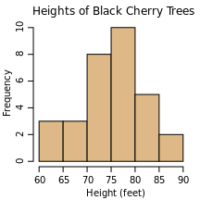
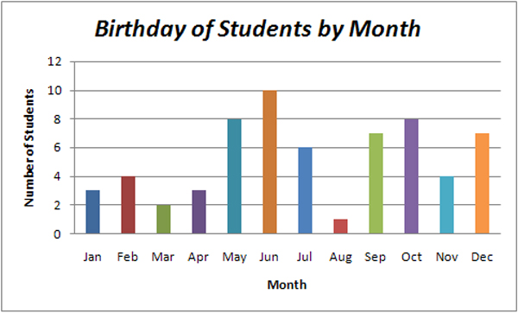
Visual Summaries of Data
Frequencies Table
Histogram vs. a bar graph?
    Histogram = quantitative/continuous data; Bar graph = categorical data,

Slide 68
Central Tendency
Mean
  Sum of all scores divided by number of scores (average)
  X --- single score (your test grade)
  ∑ --- sum (add it all up!)
  X --- mean (class average on test)
  N or n --- number of individuals/entities (number of people in class)
    X = ∑X/N
Mode (Mo)
  Most frequently occurring
Median (Mdn)
  Point at which half fall below, half fall above

Slide 69
Calculate for Likert Scale Item
[Data also on Excel File (class 4)]
5
5
2
3
5
1
4
1
2
4
3
4
5
5
5
2
3
4
3
3
Math instruction is more important than music instruction in the elementary curriculum
  (1=strongly disagree; 5=strongly agree)
M, Mo, Med
Frequency Counts (1, 2, 3, 4, 5)
Collapse data
  Disagree (1-2; n & %)
  Somewhat agree (3; n & %)
  Agree (4-5; n & %)
By hand, then at http://www.calculatorsoup.com/calculators/statistics/descriptivestatistics.php

Slide 70
Variability (spread)
5
6
8
10
11
Range
  Distance between lowest and highest score (H-L=R)
Variance
  A measure of the dispersion (spread) of a set of scores.
  For the population = The sum of the squared deviations from the mean/N (number of scores)
  For a sample = The sum of the squared deviations from the mean/n-1 (number of scores minus 1).
    Previous formula underestimates the variance in a sample. Think of -1 as a correction
  Abstract – but good for comparing groups on similar characteristics
  Needed to find SD

Slide 71
Variance Problem – Population http://www.calculatorsoup.com/calculators/statistics/descriptivestatistics.php
Data set: 5, 6, 8, 10, 11. (on a test worth 12 pts.)
Calculate the Mean
Subtract the mean from each score.
Square all the numbers that you obtained from subtracting each set number by the mean (2 neg. make a pos.):
Add the results
Divide the sum of the numbers by the number of numbers in the set minus 1.
The variance for the example set of numbers is ?.
Notes:
Answer = 2

Slide 72
Solution

Slide 73
Standard Deviation
A single number which describes the entire distribution of scores in terms of a relationship to the mean. SD=Average distance from the mean expressed in actual units (points in a test, 1-7 scale on a survey)
  SD = Square Root of [∑(X-X)²/n] or [n-1] (variance)
  SD score vs. SD unit (coming up)

Slide 74
Application (Excel Data Set)
USE: http://www.calculatorsoup.com/calculators/statistics/descriptivestatistics.php
MS Band and string students are pulled from class for lessons once per week. The MS classroom teachers are concerned that instrumental students might fall behind and score lower on standardized tests, which will affect the classroom teachers’ student growth data used in their annual performance evaluations.
Determine the M, Mo, Med, Var., & SD of 8th gr. instrumental and non-instrumental students ACT Explore scores in
  Reading
  Math
  Science
  Social Studies
  Comp.
Draw conclusions based on the data. How do inst. & non-inst scores compare? How would you respond to the MS teachers’ concerns?

Slide 75
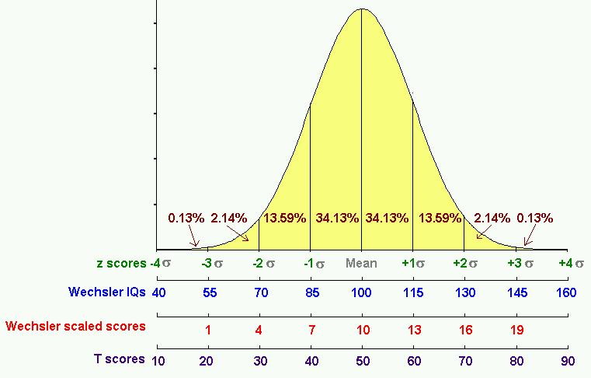
Normal Curve/Distribution
(+/- 1 = 68.26%, 2 = 95%, 3 = 99.7%)

Slide 76
More on the normal curve and variability...
Theoretical “perfect” curve. Never happens in actual research
  Mean, median, mode are equal
  50% of scores lie above mean, 50% lie below
  68.26% of scores are between one SD above the mean and one SD below the mean
  95% of the scores are within two SD’s above and below the mean
  99.7% of the scores are within three SD’s above and below the mean

Slide 77
Altogether.. describes the shape of a distribution
More on distributions..
Normal Curve (bell curve)
  Most scores clustered at the middle with fewer scores falling at the extreme highs and lows
Kurtosis - When the distribution is…
    …PEAKED = positive kurtosis = leptokurtic = greater than +2 or +3 depending on who you ask…
    …SMALLER PEAK (flatter) THAN A NORMAL CURVE = negative kurtosis = platykurtic = less than -2 or -3
Skewness - When the scores tend to bunch up…
    …on the HIGH END = Negative Skew = less than -1
    …on the LOW END = Positive Skew = greater than +1
Bi-Modal
  When there are two humps in the curve, more than one mode
[Check Skew & Kurtosis for all ACT explore scores in your subject for each group and combined]

Slide 78
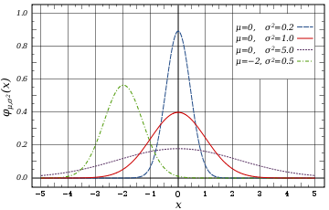
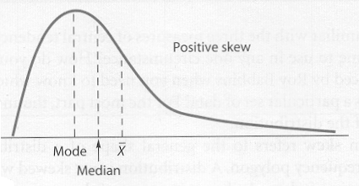
Kurtosis – shape
  platykurtic
  leptokurtic
Skew
-1 to +1 = a near normal curve
Skewed (positively)

Slide 79
Descriptive Statistics
Mean
Mode
Median
Range
Variance
Standard Deviation
Percentage
Collapsed Data

