Slide 1
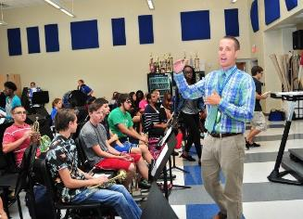
Instructional Feedback in the Music Classroom
Illinois State University
MUS 274 – Ensemble Methods I
February 10, 2017
Dr. Phillip Hash
pmh3@calvin.edu
PPT available at: www.pmhmusic.weebly.com
Notes:
Our topic today is feedback (which, among other things, is information we as teachers convey to students about them). No matter how subtle, whether intended or unintended, sends messages to students that can last a lifetime.
A STUDENT IN MY “MUSIC FOR THE ELEMENTARY TEACHER” REFLECTED ON HIS EXPERIENCE IN MS BAND SAYING THIS:
For all the years I took band I was never confident of my abilities. My instructor noticed my abilities weren’t up to par [but] instead of taking the time to help me, he would just yell at me to do it right. Not yell at me in private, but in front of the entire band. No longer was there joy for me when playing music. Going to band every other day was one of the hardest things I had to do in school. The period before band started, my stomach would begin to hurt. One gifted student switched to the baritone [and m]y instructor was always comparing me to her. The motivation was drained out of me and I stopped caring. When my last day of band came, I felt no good sentiment toward it.

Slide 2
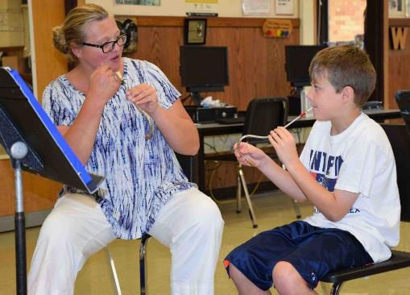
Opening
In 30 seconds, write down
  one example of great teacher feedback that you have received.
  OR
  one example of terrible teacher feedback that you have received.
    (feedback provides information & influences behavior)
Share w/ neighbor quickly
Examples of each?

Slide 3
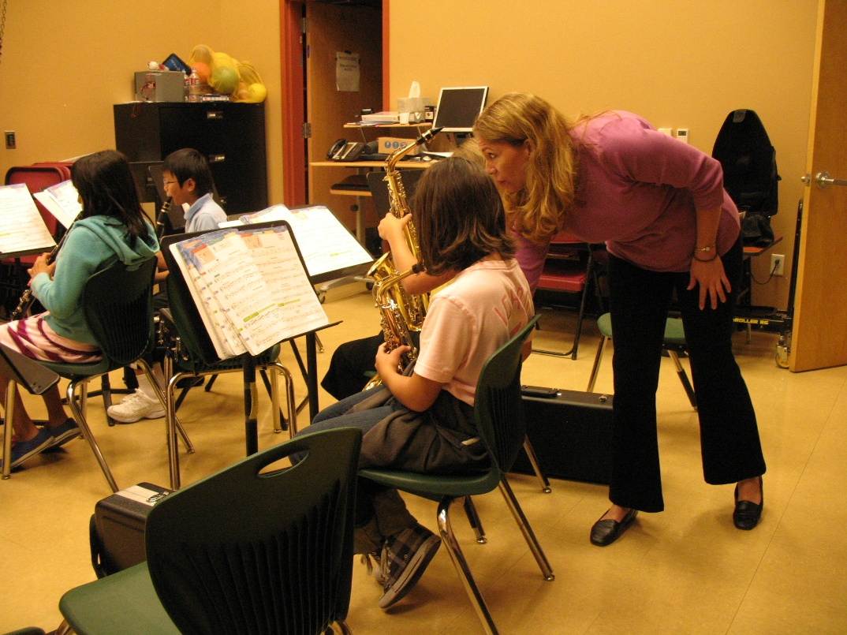
Feedback: Definition(Duke, 2009)
Any stimulus occurring with or after a given behavior that the learner associates with that behavior.
[Often] Conveys information & influences behavior.
Verbal, non-verbal
  Teacher to student(s)
  Student(s) to teacher
Notes:
Anything that happens in connection with something a learner does that [often] conveys information and influences behavior.

Slide 4
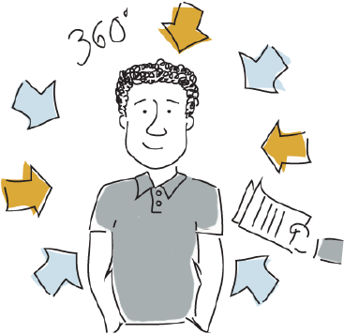
Four Principals (Duke, 2009)
“Feedback can come from almost anywhere.”
  Teacher only one source
  Parents, media, community, peers
“The function of feedback is independent of it’s intent”
“A given feedback may function differently for different learners and in different circumstances”
“The association b/w feedback and behavior need not be explicitly recognized in order to exert an effect on behavior.”
Notes:
SOURCES OF FEEDBACK
Parents, media, community, peers
Ex: 5th grade euph player who quit unexpectant. Feedback from me was positive & supportive; parents = indifferent; peers & coaches on basketball team??
UNINTENDED: “The teacher who dresses unprofessionally, allows the rehearsal room to be messy, is unorganized…”
Likewise student send feedback they might not intend – avoid taking student responses personally. They might not reflect true attitude.
FUNCTION DIFFERENTLY
Imagine two alto MS sax players at solo/ensemble contest. They play the same solo at about the same level and get a div II rating. Player one always receives a div 1 and is frustrated at the rating. He blames the judge, instrument, etc. Ignore the judges helpful feedback and rationalize the performance.
Player 2 has never played a solo before and is satisfied with the rating and encouragement from the judge. She goes home and starts to apply the advice she got to improve her playing.
Some students might be motivated by a “tough” “strict” “demanding” conductor. “You don’t yell at us enough”. Others might quit playing.
UNRECOGNIZED CONNECTION: “My students are not ready so I get in the habit of counting off – then they stop watching altogether…”

Slide 5
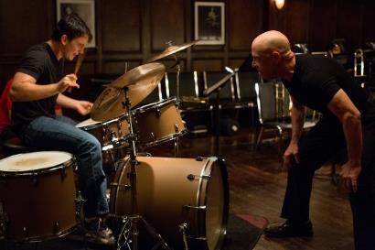
Feedback = Information
Specific vs. vague
Descriptive vs. judgmental
Student (recipient) vs. teacher (sender) focused
Accurate vs. inaccurate
Simple or complex
  Developmentally appropriate?
Positive vs. Negative
Concise or long
Verbal or non verbal
Metaphorical or literal
  https://www.youtube.com/watch?v=SleO38Km03w (Dudamel)
Notes:
EXAMPLE: “Upper WW (who): Mes. 35-43 (where) sounds very dance like (how) b/c of how light you are playing the 8th notes (why - transfer)”; “35-43 – articulation is much better;” “good job!”
“Good, bad, weak, etc.” are judgement words. What are some other single words that could apply to a quality performance? Consider: effective, expressive, articulate, precise, etc.
EXAMPLE: “I liked how you…”
Simple or complex – consider the level of the students
Ex: Phrasing – 5th grade band vs. HS Wind Ensemble
Positive – identifies and reinforces desired behavior (first example)
Negative – identifies and discourages undesired behavior (Duke [2009]) Nothing wrong with negative feedback. [corrective &/or constructive feedback]
EXAMPLES: Sometimes confuse negative feedback with negative emotion “Alto saxophones, 3 after letter C – which note are some people playing incorrectly?” OR “Saxes! 3 after C - F#!!!”
Verbal/Non-Verbal: Examples of Nonverbal feedback we give students? [You played {conduct} but we need this {conduct}}.
They give us?

Slide 6
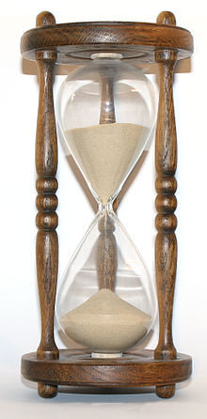
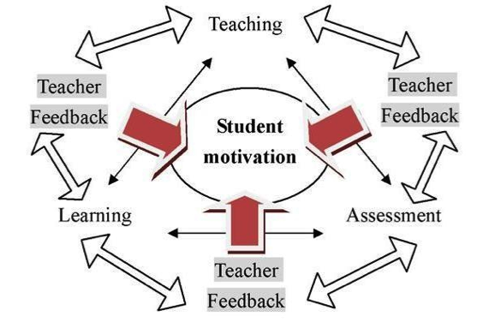

Feedback = Motivation for Change
Our success to motivate depends on:
  Based on relationship
  Student attitudes
  Delivery
  Timing
Macro
Micro
Macro
Notes:
Based on relationship
Think about whose feedback you value. Private teacher, conductor, HS director, parents, peers, etc.
Exception = recognized expert
Student attitudes – Negative attitudes most difficult to influence
Delivery
“Am I doing something that turns students off?” Being too silly w/ HS students? Condescending in any way?
Timing
In rehearsal – Macro – Micro – Macro – when to provide feedback on broad vs. specific aspects of performance
Behavior – wait until emotions have subsided. Ex: A student returning to the homeroom in tears after a failed solo/ensemble performance probably isn’t ready to hear how they didn’t practice enough.

Slide 7
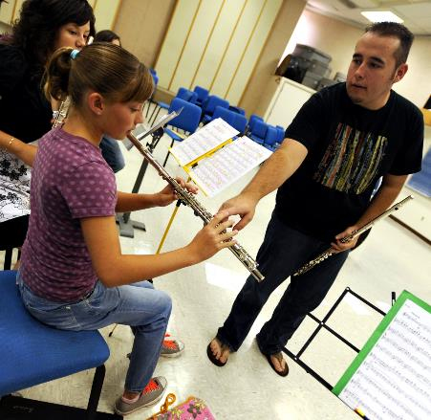
Teacher Control of Feedback
Expert teachers give a lot of positive & negative feedback.
“To think about feedback only after the student has done something is to think about feedback too late.” (Duke, 2009)
  Teaching = proactive
  Correcting = reactive
  Who controls what happens next in the classroom?

Slide 8
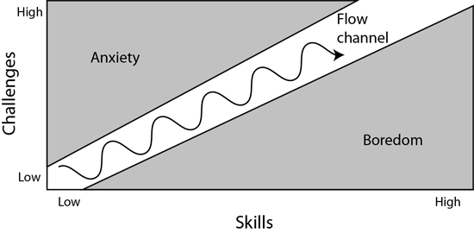
Teacher’s Role in Controlling Feedback
Teachers control rate and type of feedback by selecting learning activities, thus regulating challenge & predicting what will happen.
Zone of Proximal Development (Lev Vygotsky)
Flow - Mihály Csíkszentmihályi
  Mental state in which a person is fully immersed, focused, & energized in an activity.
  Balance b/w challenge & accessibility
  Differentiate instruction to maintain flow for maximum number of students
Notes:
Learning activities that result in flow will provide opportunities for a balance b/w positive/negative feedback.

Slide 9
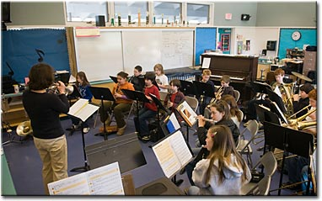
Analyze Feedback (give examples) https://www.youtube.com/watch?v=tMJkl3IABAs
TEACHER TO STUDENTS
  Specific or vague?
  Descriptive or judgmental?
  Positive or negative?
  What else??
How well do you suspect this teacher controls rate/type of feedback?
STUDENTS TO TEACHER
Notice:
  engagement
  result of teacher feedback
Notes:
Take our something to write with & something to write on.
Teacher Feedback in relation to:
Try to focus on feedback rather than other issues with playing, conducting, etc.

Slide 10
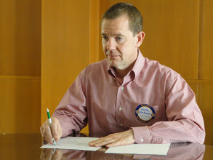
Written Feedback
Documents feedback for student & teacher
Include narrative (vs. score/grade only)
Allows teacher to think a bit more
Perhaps provide more detail
  Recording allow multiple hearings

Slide 11
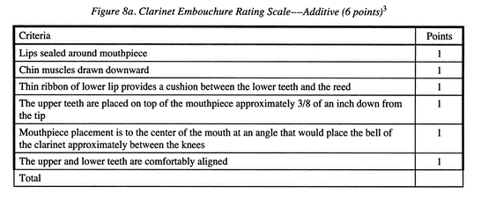
Rubric
Examples
http://assessment.rbe.sk.ca/node/104
Benham, S. (2010). Musical assessment as an impetus for strategic, intentional, and sustainable growth in the instrumental classroom.
In T. Brophy (ed.), The practice of assessment in music education: Frameworks, models, and designs (p. 145-170). Chicago: GIA.

Slide 12
Rating Scale
Score for each dimension
Narrative Comments
  Complement, criticize, & correct
https://www.youtube.com/watch?v=eAJ338KJRkA (Katiana – 5th gr. clarinet)
https://www.youtube.com/watch?v=1BKomQUMnq0 (Emerson – 6th gr. tuba)
Notes:
Choose one or two categories/dimension and write narrative that complements, criticizes, and corrects. Be prepared to share with the class.

Slide 14
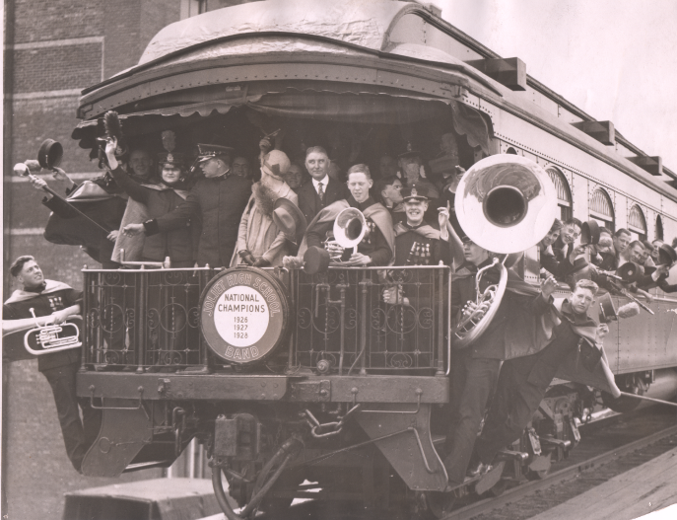
Closing & Assignment
A. R. McAllister of the JTHSB gives what is probably negative feedback to euphonium player as band leaves for national contest in Denver, CO - 1929
Notice all feedback you give and receive today in relation to our discussion
https://www.youtube.com/watch?v=dP4kXJ92Qh4 (Simon Rattle w/ 6 school orchestras in Germany)

