Slide 1
Historical Research &
The National School Orchestra Contests: 1929-1937
Phillip Hash
Calvin College
Grand Rapids, MI
pmh3@calvin.edu
www.pmhmusic.weebly.com

Slide 2
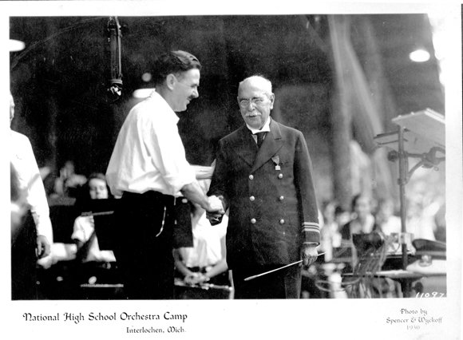
Introduction
Personal Story (family of collectors)
In music education
  Vicarious models (Bill Lee) reveal success over time
    Joseph Maddy
    A. R. McAllister
  Successful strategies never go out of date
    “Do more in less time”
    constructivism, learning-by-doing

Slide 3
Why History? (Heller, 1998)
satisfy interest or curiosity
understand current conditions or practices [vs. “we’ve always done it that way”]
supply missing information or complete the record
correct errors in the existing record
verify the existing record [Birge, Mark & Gary, Keene, etc.]
explain complex ideas
“What history [provides] is an understanding of possibilities that results from knowledge of past achievements and ‘a nostrum against despair’” (p. 6), as well as a source of pride, identity, and inspiration, especially when times are difficult. (Heller, 1985)

Slide 4
McCarthy (2009)
When the past is forgotten, its power over the present is hidden from view. ‘We are victimized by an amnesia which makes ‘what is’ seem as if ‘it had to be.’’ (Kincheloe, 1990, fall)
Here [Ken Burns] gets at the core value of history, with implications for professional knowledge and practice: ‘The present is simply the developing past, the past the undeveloped present. The historian strives to show the present to itself by revealing its origin from the past. How present the past is, how rich our lives are.”

Slide 5
Four More Reasons
Expand our knowledge of music education beyond the common narrative.
Document the details surrounding important ensembles, programs, and directors.
Identify past practices in order to gain an understanding of why we do what we do today or reveal forgotten strategies that might be useful now.
Trace current practices back to their historical roots to determine their initial purpose (vs. “we’ve always done it that way”) and evaluate their efficacy in light of contemporary goals and values.

Slide 6
Approaches (Humphrey’s, 1998)
Event/narrative vs. social/cultural history
“…philosophers and historians should begin to discuss issues of interest and concern, including histories of formal and informal music education between and across nations and cultures, ethnic and gender issues, the role of music education in changing musical practice, and many more
“mainstream musicologists [and music educators?] traditionally have not been interested in "ordinary" music or in the musical practices of the great masses of people[, students, or teachers]. For the most part, music education historians also use narratives to describe important and interesting people, events, and institutions.

Slide 7
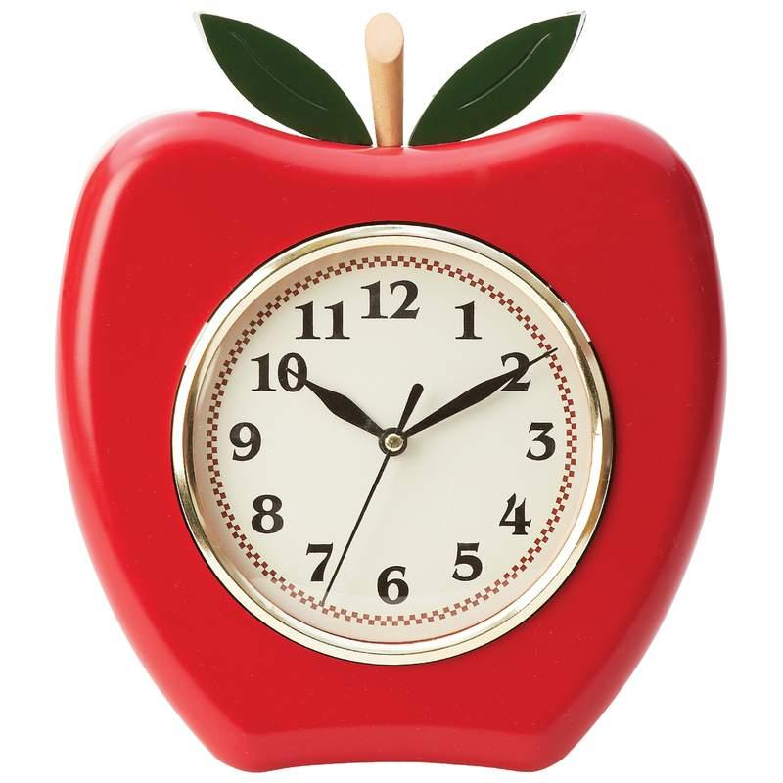
Practical Advantages
Accessible working teachers or professors in small colleges
  Less time constraints – Data just gets older!
  Flexible scheduling vs. need to visit schools during school hours
  IRB not required unless conducting oral history
  Possible topics abound!
  Many online resources available to get you started
Wider audience(?) – esp. for local history
People willing to help (Internet makes long distance communication easy)

Slide 8
Online Resources
Google Books http://books.google.com/
Hathi Trust http://www.hathitrust.org/
Internet Archive https://archive.org/
IMSLP http://imslp.org/
BandMusicPDF Libraryhttp://www.bandmusicpdf.org/
Family Search https://familysearch.org/
HeritageQuest (US Census) Univ. of MI Library or State Library of MI. Free to all MI residents
Music Trade Review & Presto http://www.arcade-museum.com/library/search-music/
Wiki Newspaper databases http://en.wikipedia.org/wiki/Wikipedia:List_of_online_newspaper_archives#Wisconsin
Chronicling America http://chroniclingamerica.loc.gov/
Google News Archive http://news.google.com/news/advanced_news_search?as_drrb=a
ProQuest Historical Newspapers
GenealogyBank http://www.genealogybank.com/gbnk/
Newspaper Archive http://newspaperarchive.com/

Slide 9
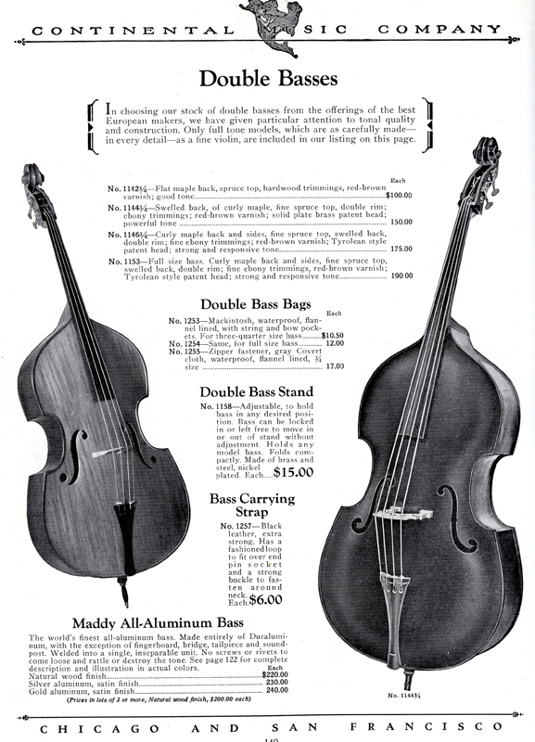
Topics & Resources
Joseph Maddy/ICA Collection – Bentley Historical Library
  Aluminum string instruments(!)
  Radio lessons
  Work in MSNC/MENC
  Michigan All-State Orchestra/Band
The School Musician magazine
  Official publication of the NSOA/NSBA
  State & National Contests (esp. Midwest), pedagogy, industry, etc.
Other sources in music library and Buhr remote shelving facility

Slide 10
MTR June 9, 1927 & Feb 1931

Slide 11
National School Orchestra Contests: 1929-1937
Study in Progress

Slide 12
School Orchestras
Early Examples:
  Newark, New Jersey (1862)
  Newport, Rhode Island (1875)
  Cincinnati, Ohio (1878)
  Aurora, Illinois (1878)
  Jackson, Michigan (1879)
Development increased @ 1900-1920 due to values of progressive education
Seven Cardinal Principals of Education
  1) health
  2) fundamental processes (the 3 Rs)
  3) worthy home membership
  4) vocational skills
  5) citizenship
  6) worthy use of leisure time
  7) ethical character.
Music teachers justified orchestras saying that these ensembles 1) developed concentration and mental discipline (3 Rs), 2) brought music into the home (worthy home membership), 3) developed a work ethic and provided employment opportunities (vocational skills), and 4) fostered teamwork and community (citizenship). They furthermore stated that instrumental instruction 4) kept children off the street (worthy use of leisure time), and “[gave] pupils…the right kind of emotional reaction at the right age” (ethical character)
1911 – MSNC recommends academic credit

Slide 13
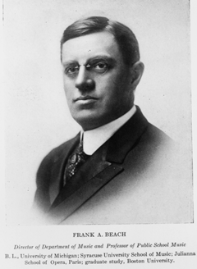
Contests
Data to ancient Greece & Medieval Europe
Came to US in 18th century for voice, fiddle, church choirs
Kansas Musical Jubilee – 1893
  Included HS choirs classified w/ adult groups – 1897
  Separate class for grammar school choirs – 1897
  Ended in 1903 but inspired KS school music contests beginning 1913. Included orchestras & bands by 1917
National School Band Tournament – Chicago: 1923

Slide 14
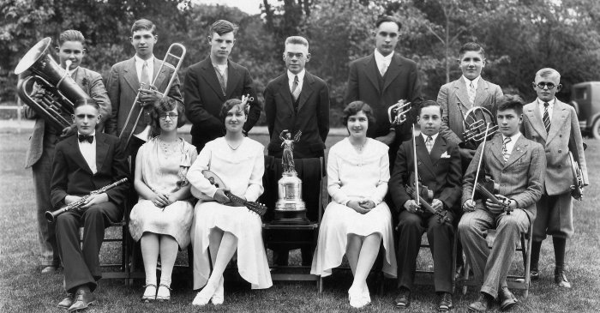
National School Orchestra Contest
Extension of National School Band Contests: 1924
  National Bureau for the Advancement of Music led by Charles M. Tremaine
  Committee on Instrumental Affairs of MSNC led by Joseph E. Maddy of the Univ. of MI
  Funded by Band Inst. Manufacturers
  Included system of state, regional, & national contests
Orchestra Contests
  16 state contests & a New England sectional – 1928
  National contests – 1929 at the Univ. of IA, Iowa City
Bellows Free Academy – 1928/1929 VT class B state winners

Slide 15
1929 National School Orchestra Contests
University of Iowa
14 groups, 7 states
Class A & B (school size)
1 JH Orchestra
Rank based on composite score from 2 rounds
Each group played a “test piece,” a selection from CIA list, & sight-reading
Required = “Egmont Overture” by Beethoven (A) & “May Day Dance” by Henry Hadley (B)
Concluded with a massed performance of 500 top players from the competing orchestras. University radio station, WSUI, broadcast the finals, massed concert, and awards
Class | Orchestra | State | Director | % Score | Rank
A | Peoria Combined HSs | Illinois | L. Irving Bradley
A | Springfield HS | Illinois | Ruth Soulman
A | Hammond HS | Indiana | Adam P. Lesinsky | 94.3 | 2
A | East HS - Waterloo | Iowa | G. T. Bennett | 87.2 | 4
A | Neodesha HS | Kansas | Edward P. Rutledge
A | Central HS - Flint | Michigan | Walter Bloch | 91.6 | 3
A | Lincoln HS | Nebraska | Charles B. Righter | 96.4 | 1
A | Johnson City HS | Tennessee | Margaret Haynes Wright
B | Flora HS | Indiana | C. R. Young
B | Michigan City HS | Indiana | Palmer J. Myran | 81.2 | 2
B | Benjamin Franklin JHS – Cedar Rapids | Iowa | Frederick Doetzel
B | Sigourney HS | Iowa | Paul R. Hulquist
B | Decatur HS | Michigan | Aileen Bennett | 75.3 | 3
B | Mount Clemens HS | Michigan | Paul H. Tammi | 85.8 | 1

Slide 16
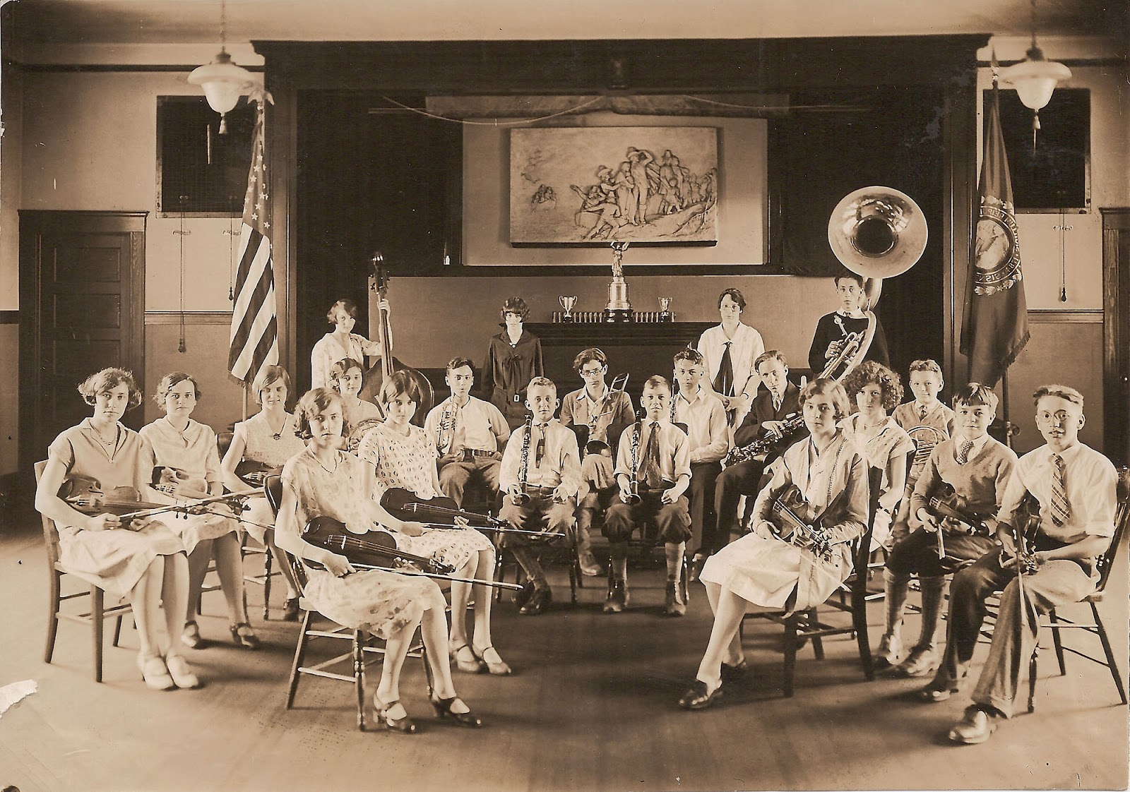
Growth of the Contests
Approximately 500 orchestras participated in state-organized contests in 1930 and about 700 in 1931
Subsequent Contests
  1930 – Lincoln NE
  1931 – Cleveland OH
  1932 – No contest - depression
  1933 – Elmhurst IL
    Cent. of Progress & rating system
  1934 – Ottawa KS
  1935 – Madison WI (alt. years)
  1937 – Columbus OH (OSU)
  1938-1942 – Regional Competition/Festivals
Hampton, New Hampshire HS Orchestra – NH 1st place - 1929

Slide 17
Adjudication
Ranking vs. Rating
Instrumentation (100 pts. [x2])
  79 piece standard instrumentation
  -½ for each missing instrument or -¼ for each saxophone substitution (until 1933)
Tone, Intonation (1930), Interpretation, General Effect (100 pts. x 2 pieces = 800 pts.)
Sight reading = 20-25%
Judges included professional musicians, conductors, & composers, as well as school music educators
  Howard Hanson – composer/conductor
  Carl Busch - composer
  Emil Herrmann – concertmaster: Cincinnati Symphony Orchestra
  Will Earhart - Pittsburgh Public Schools

Slide 18
Adj. Forms/1931 & 1936

Slide 19
1928 State Winners (notice instrumentation)

Slide 20
Trophies & Medals Provided by NBAM

Slide 21
Conclusions & Recommendations
Contests stopped evolving after 1932 & resemble current practice
  Adjudication forms (vs. MSBOA)
  Classification (often on school size)
    Probably results in exclusion of neediest groups/teachers
    Required repertoire list
    Sight-reading difficulty
    Rating (I – V). [Is this really non competitive?]

Slide 22
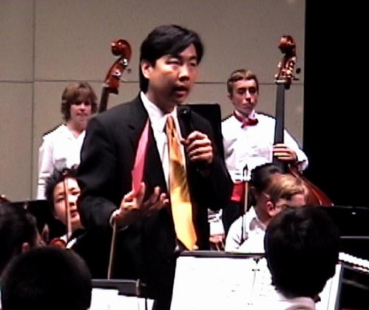
Next Evolutionary Step?
Narrative feedback/comments w/o scores or ratings(?)
  Would allow for other changes
  Discourage use of ratings in teacher evaluation
  Encourage a true festival atmosphere that welcomed groups of all levels and stages of development
“In our state the contest has become a grading system. Teachers wait like naughty third-graders in the principal's office for the stamp of I, II, III, IV, or V in indelible ink on the bare skin of their year's work. This process scarcely soothes the breasts that grew savage at a contest…The intent was noble. Instead of letting one contest winner reduce all the others to the status of loser, the tonic effect of winning was to be spread out. But what was actually spread out was the dismal effect of losing. There are many new ways of losing which the original contests lacked that the grading system has exploited.”
“…we should be training children out of competitiveness rather than consistently goading them into it. We should be giving our teachers real help: demonstrations, answers to questions, reaffirmation of highest purpose, rather than adjudications. All of us, teachers and students and judges, should be pooling our powers and experiences for mutual help, rather than trying to be better than each other.” H. R. Wunderlich (MEJ, 1951)

Slide 23
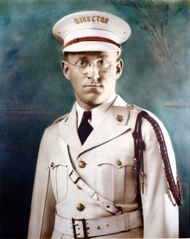
Other Recommendations
Allow individual directors to choose classification (e.g., VA)
or eliminate classifications
Invite professional composers, conductors, & musicians to adjudicate
  Bring a unique perspective compared to other school directors serving as judges
  “…I began to get disenchanted with the contest as a teaching aid….[T]he judging of the contests was moving out of the hands of the professional musicians into those of people in academia, especially those in college and university music departments. I am not saying that these people were inferior to the prewar professional judges, but they had different standards and they looked for different things in the [ensembles] they heard. I did not share their outlook, because I myself am from the profession. I began to feel more and more out of tough at contest time.” T. Paschedag – Director, West Frankfort IL: 1930-1952) The Music Came First: The Memories of Theodore Paschedag

Slide 24
References
Heller, G. N. (1985). On the meaning and value of historical research in music education. Journal of Historical Research in Music Education, 32(1), 4-6.
Heller, G. N. (1998). Historical research in music education: Definitions and defenses. Philosophy of Music Education Review, 61, 84-85.
Humphreys, J. T. (1998). The content of music education history? It's a philosophical question, really. Philosophy of Music Education Review, 6, 90-95.
McCarthy, M. (2009). Knowing the past, understanding the present, enlightening the future: Values and processes of doing historical research in music education. Finnish Journal of Music Education, 12(1), 84-91.

