Slide 1
On the Road to Marzano
A TCAPS K-12 Music Perspective
Traverse City Area Public Schools

Slide 2
Take Aways
You will leave here knowing ...
how one district is ‘chunking’ the Marzano process
what is helpful to have already in place
what learning goals and scales can look like in the music classroom
that evaluating your music teachers can be fun and enjoyable without being intimidating for either party

Slide 3
A Little Bit About Us
Traverse City Area Public Schools is the largest school district in Northern Michigan. Our district covers over 300 square miles and over 10,000 students pk-12. We have 14 elementary schools, 2 middle schools and 3 high schools. We offer music education through elementary general music pk-5, middle school and high school performing ensembles in vocal music, band and orchestra.

Slide 4
Before Marzano We
had recently updated elementary and secondary music curriculum to align with current practices within the district
were using district wide common assessments to measure student growth, they have been in place K-12 since 2007
regularly met as Professional Learning Communities (music specific) 6 times a year
had a half time k-12 music coordinator, staff involved at district level with school improvement and instructional rounds
had music staff involved at state level organizations

Slide 5
November 2013
Regional Staff Development Day
All staff was introduced to the domains of Marzano and the fact that TCAPS was going to focus on four specific elements the first year.

Slide 6
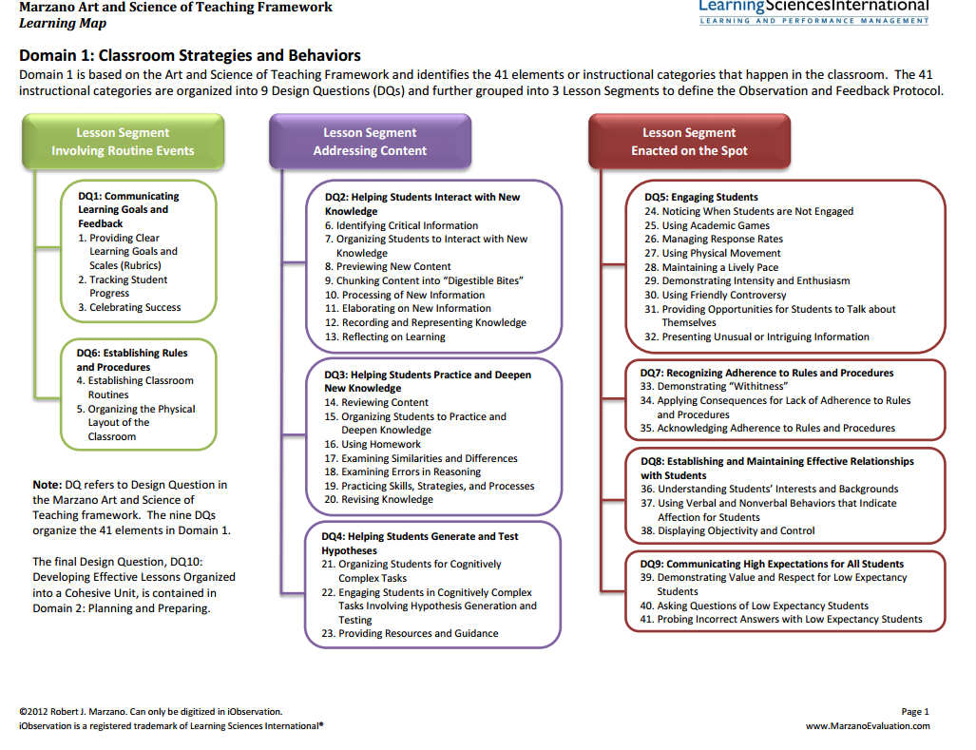
In the final evaluation distribution, these four elements will make up 60% of the overall score.
Orange arrows indicate a TCAPS area of focus.

Slide 7
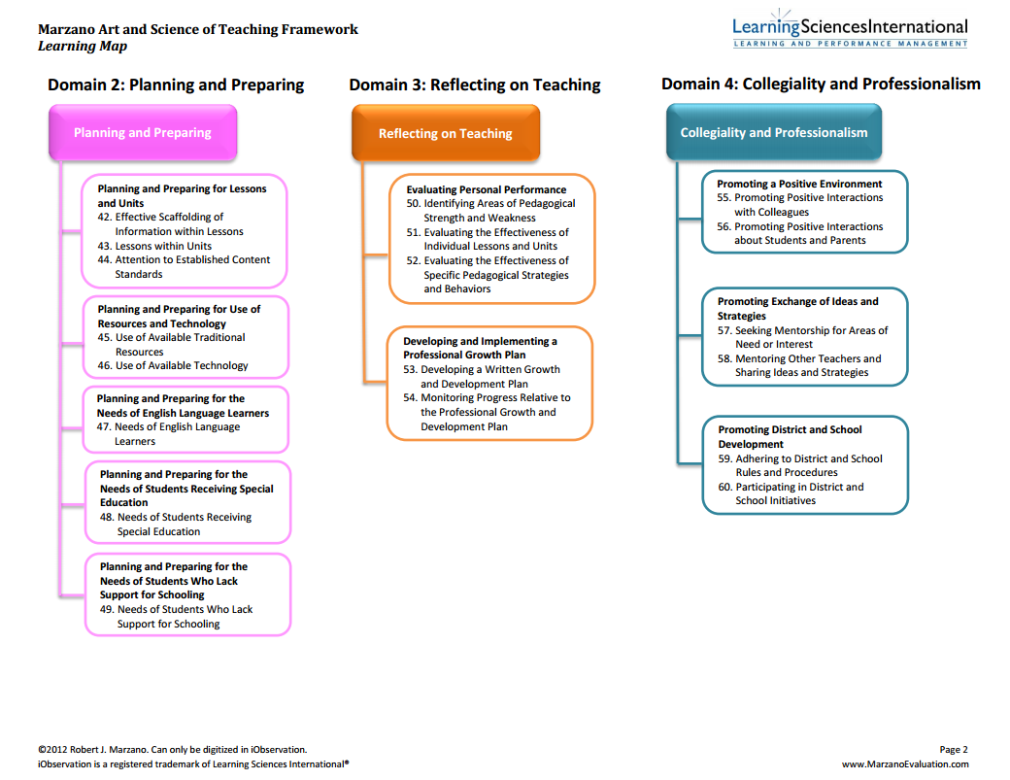
Orange arrows indicate a TCAPS area of focus.

Slide 8
February 2014
Staff introduced to NAfME and NCCAS support materials for standards revisions
Began to create backward lessons and then units to align with district initiatives
Summer work for elementary and secondary
existing 7 elementary general music strands aligned with NCCAS
Secondary units in performance and literacy to align with national standards, district initiatives and 21st century skills
Planned for summer work, writing units that focused on performance and literacy.
ggtacs

Slide 9
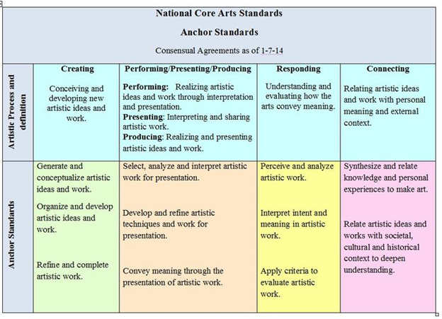
New Core Arts Standards implemented
in
Summer 2014

Slide 10
May 2014
ISD provided Marzano training for fine arts teachers; teachers began to practice writing Learning Goals and Scales
Reviewed curriculum and determined where overarching Learning Goals and Scales were appropriate
All teachers were asked to self assess their knowledge of Marzano four domains and set evaluation goals for 2014-2015.

Slide 11
Where We Started
General Music decided to begin work with our foundation strands of singing and rhythmic literacy. We already had rubrics in place that were easily translated.
I can sing in tune and in head voice
I can read familiar rhythmic patterns
accurately, keeping a steady beat
3

Slide 12
Secondary Goals/Scales
Secondary performance classes developed two tracks for assessments and goals/scales development.
Performance
Skills/Technique
Interpretation/Artistry
Literacy
Music Theory
Sight Reading

Slide 13
Summer 2014
Continued work on curriculum alignment
with assessments and learning goals and scales in mind
Began to brainstorm how to efficiently track student progress to support student growth

Slide 14
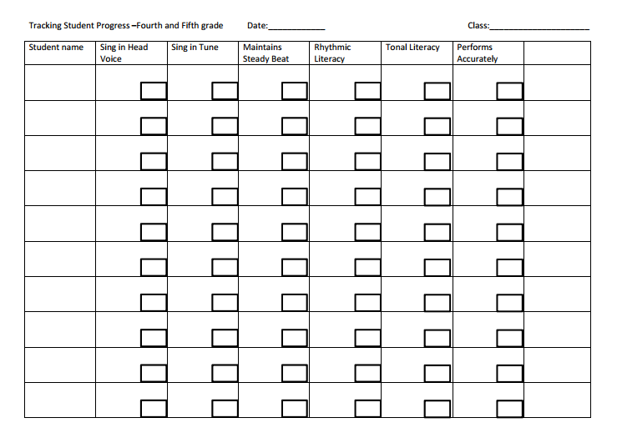
How do we track student progress?
Multiple scores in each skill area can be recorded.
This chart was inspired by a similar chart viewed in a Marzano present-
ation.
We designed it to be grade level specific and it aligns with our report card

Slide 15
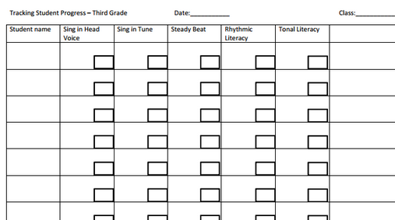
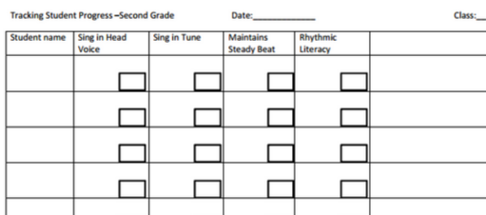
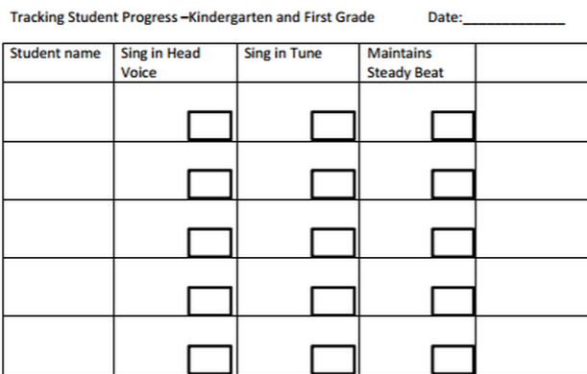

Slide 16
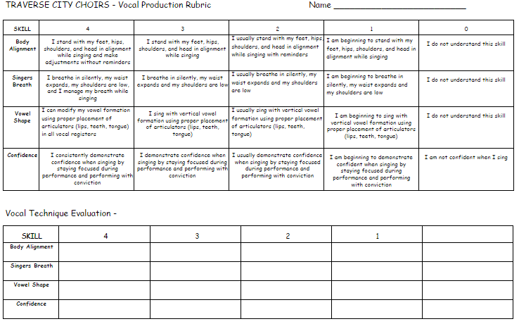

Slide 17
Starting With A Generic Scale
Fall of 2014 -
Everyone was expected to have something posted (no matter how basic) - generic scales were a great way to start

Slide 18
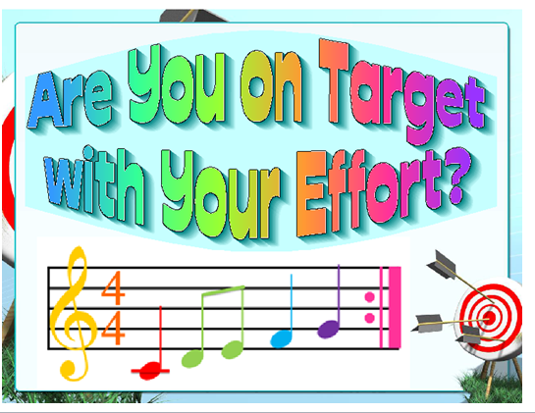
www.ariosostudio.com

Slide 19
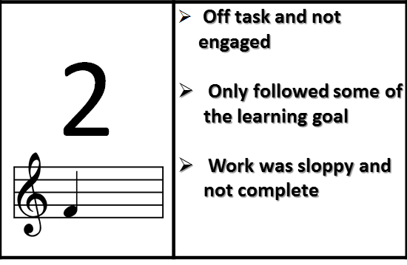
www.ariosostudio.com

Slide 20
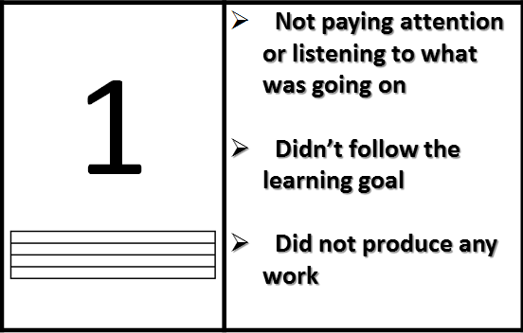
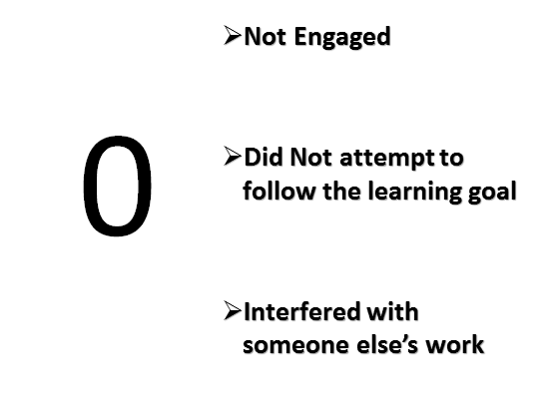
www.ariosostudio.com

Slide 21
September-October 2014
Informal Observations occurred
Staff completed growth plan/IDP
Mostly staff focused on:
#1 - Learning Goals & Scales
#2 - Tracking Student Progress
Student growth indicators determined

Slide 22
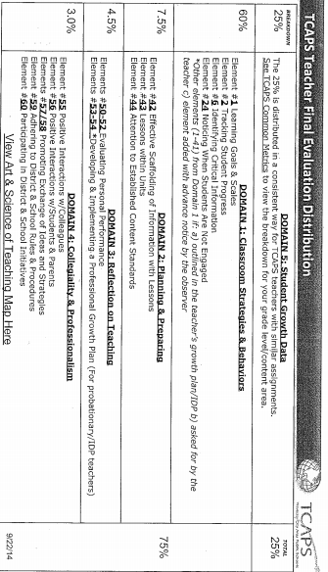

Slide 23
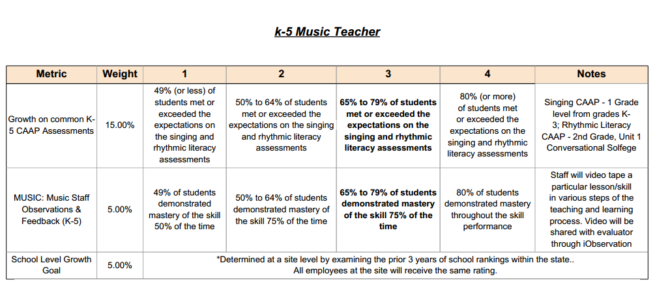
November-December - Defining Growth K-5

Slide 24
K-5 Individual Common Assessments -
Singing -
K-1 “Who has the…” in F
2-3 “Liza Jane refrain in E-flat
4-5 “America the Beautiful” in C
Rhythmic Literacy -
Conversational Solfege Units:
2 - Unit 1
3 - Unit 6
4 - Unit 3
5 - Unit 7
(these are currently being realigned)

Slide 25
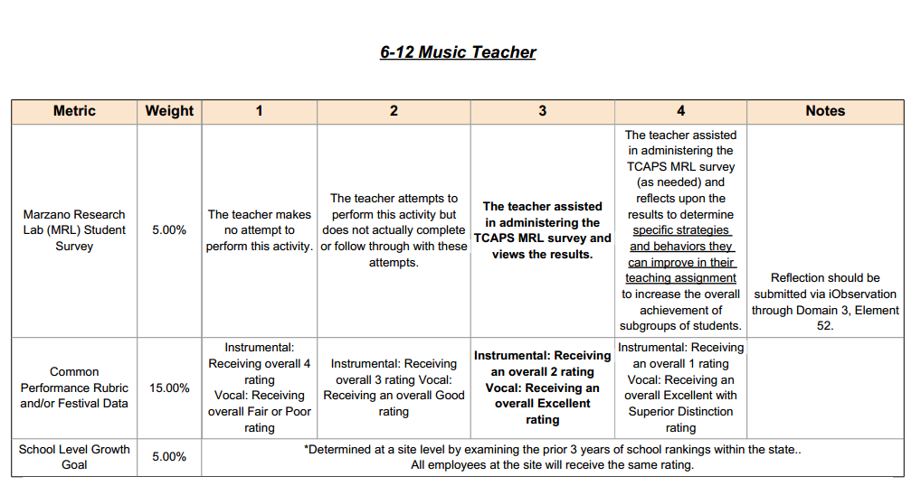
Defining Growth- Secondary Performing Ensembles

Slide 26
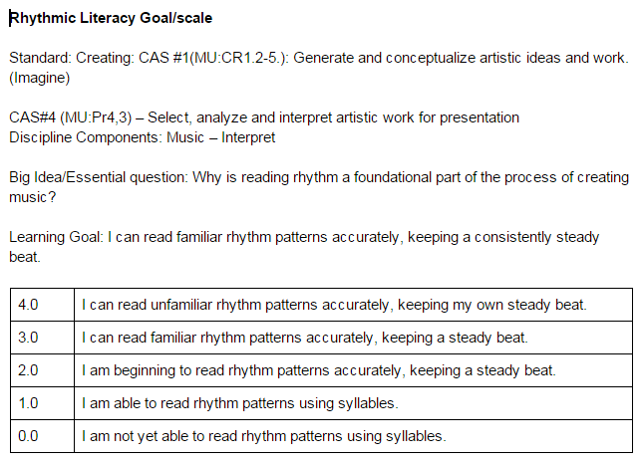
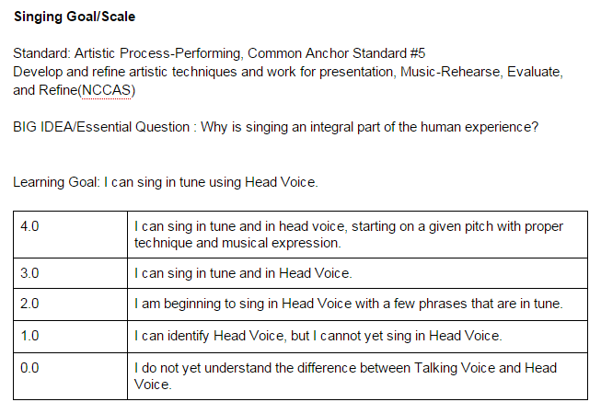
January-February
Fine Tuning Scales...

Slide 27
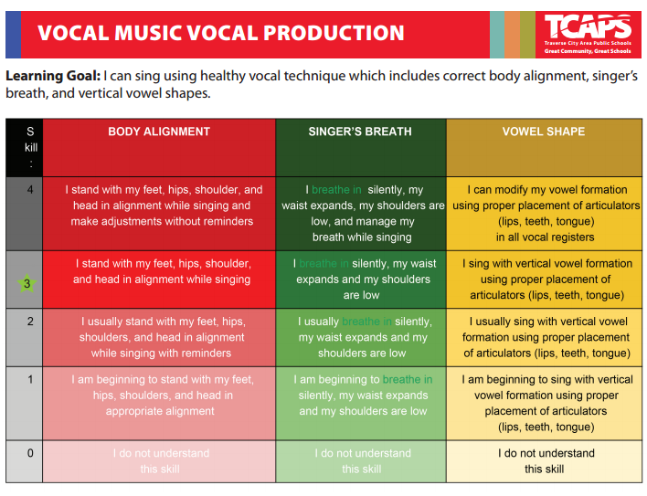
Secondary Vocal Music

Slide 29
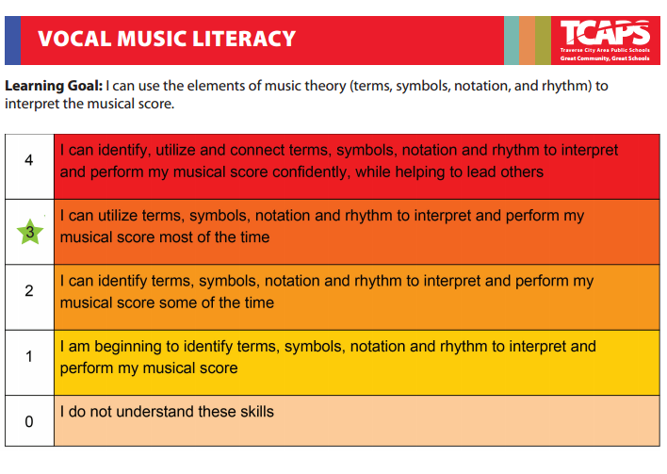

Slide 30
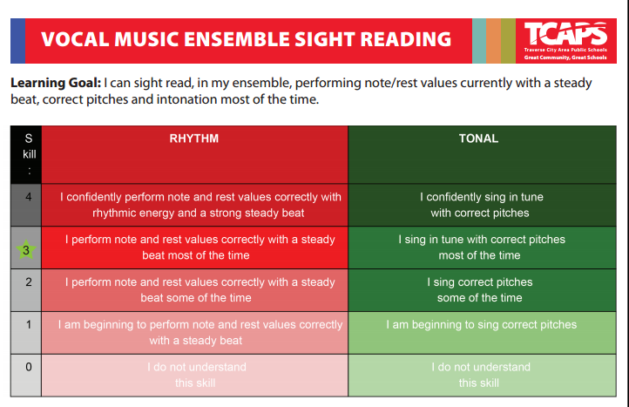

Slide 31
Learning Goals And Scales In Action
S
Singing Lesson with Goal and Scale
http://youtu.be/hn0vMZe2Nmc

Slide 32
Student Responses
What is a learning goal and scale
http://youtu.be/_ZSbq97_Rso
students like rating themselves
scales can be used for classroom management

Slide 33
Common Assessments
TCAPS is reviewing if our assessments are truly assessing what we think they are.
Do our assessments reflect those key areas of instruction that we value?
What is the appropriate balance of “individual” vs. “ensemble” assessments

Slide 34
Moving Forward
Expand the bank of assessment tools for informative and summative assessments that support the curriculum objectives
Practice using the goals and scales in the classroom so they feel natural
Continue to utilize the state and national support materials for authentic assessments

Slide 35
Ready, Set, Evaluate

Slide 36
Designing Your Road, Some Suggestions
teachers in the music classroom are always assessing, let that natural part of the “practice” be the assessment focus
individual assessments must be practical and manageable as well as informative
“ensemble” assessments should be considered as well

Slide 37
Random Thoughts
Begin with the end in mind
Process vs Product
Don’t reinvent the wheel
Music and Marzano work well together
It’s easier to write goals and scales when you have an established curriculum
Students like rating themselves even our youngest learners

Slide 38
Evaluation Is An Investment
training
reflection
resources
TIME to
meet
observe
reflect
design and redesign

